Slide 1
Liquid TME

Slide 2
Inferring Tumor microenvironment (TME) from cfDNA
Tumor
biopsy
Immune checkpoint inhibitors (ICIs) transform a subset of tumor-infiltrating leukocytes (TILs) into cancer-killing cells
Unfortunately, most patients do not respond
in large part due to the cellular composition of Tumor
Currently physicians do not monitor the cellular composition of Tumor
requires invasive biopsy serially
cannot predict the response
LiquidTME: Can we monitor tumor cell composition from blood?
Blood draw
Recognize the signature of tumor cell composition computationally
Notes:
Ok
ICI a type of cancer treatment uses the immune cells, the leukocytes to kill the cancer cells
But it does not work always. Serious side effects may occur too. The response of a patient depends on the profile or cellular composition of the tumor.
And the bad news is we cannot monitor the tumor because.......(read slide)
so we cannot predict the response of the treatment in advance
Here, we are proposing a technique, LiquidTME, to monitor the tumor noninvasively from blood.
So instead of tumor biopsy, we draw the blood and
try to profile the tumor from blood computationally

Slide 3
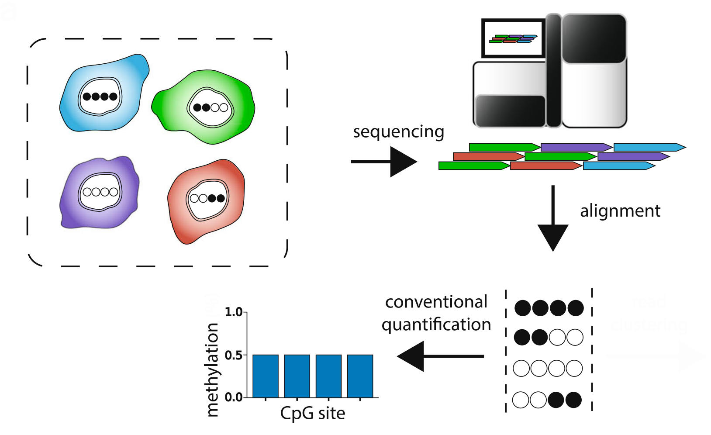
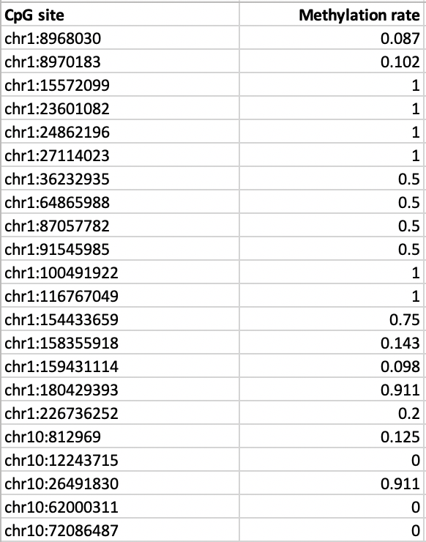


Read Counting Approach
Cells
Methylation file
Methylated CpG
Unmethylated CpG
Read counting works on Bam file
Traditional Deconvolution works on this
Scott et al. Genome Biology (2020)

Slide 4
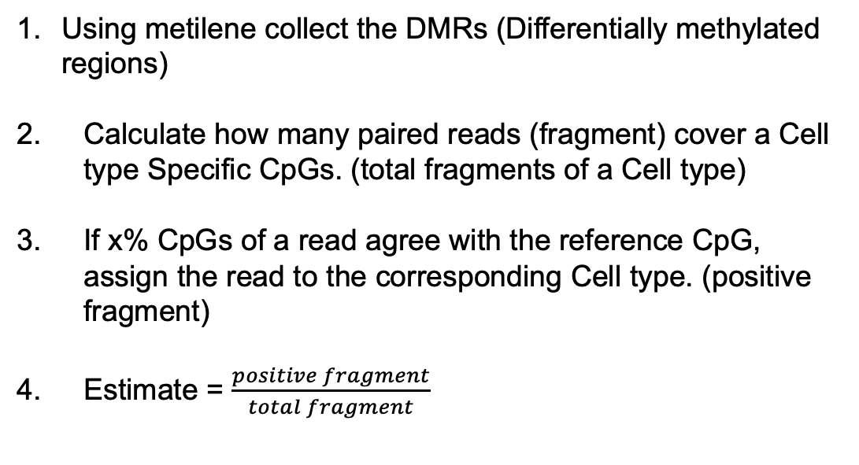
Read (fragment) counting method
Using metilene collect the DMRs (Differentially methylated regions)
Calculate how many paired reads (fragment) cover a Cell type Specific CpGs. (total fragments of a Cell type)
If x% CpGs of a read agree with the reference CpG, assign the read to the corresponding Cell type. (positive fragment)
Estimate = $\frac{positive fragment}{total fragment}$

Slide 5
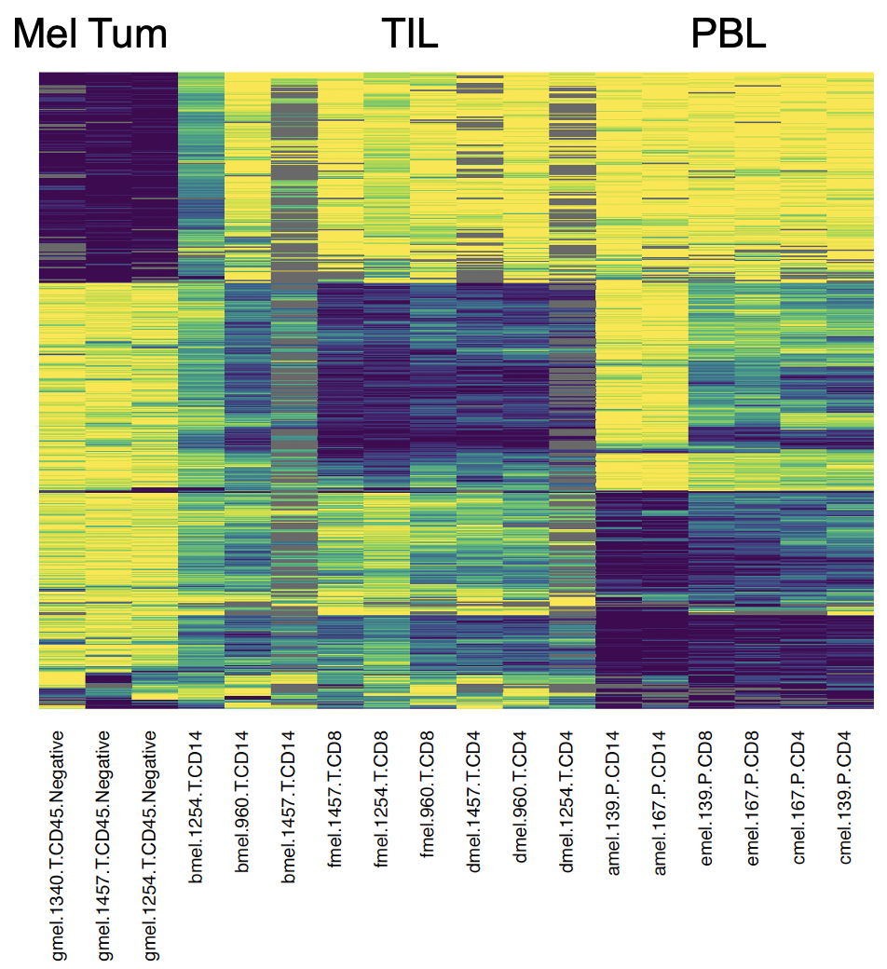
Reference for melanoma cfDNA

Slide 6
Response prediction using PBL

Slide 7
Response prediction using TIL

Slide 8
Response prediction using Mel tumor

Slide 9
Whole blood RNA-seq deconvolution

Slide 10
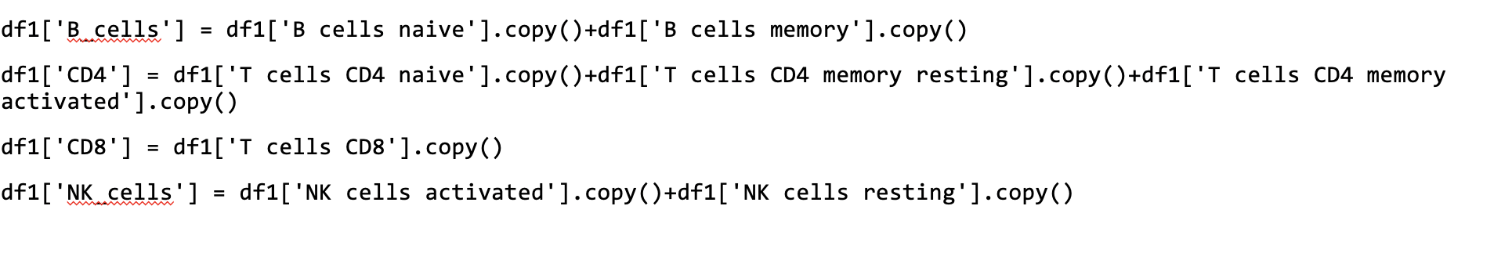
Overview
Here we showed the whole blood (out latest data) RNA-seq deconvolution (CSx) result using LM22
To adjust LM22 with the ground truth, the following combination is performed:

Slide 11
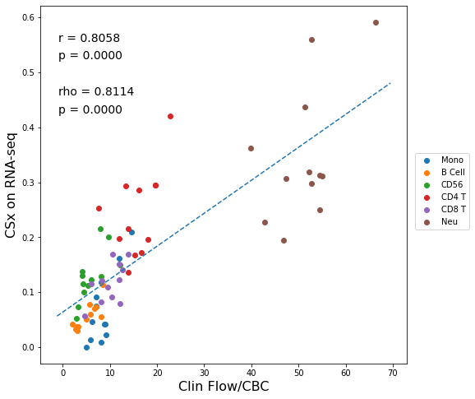
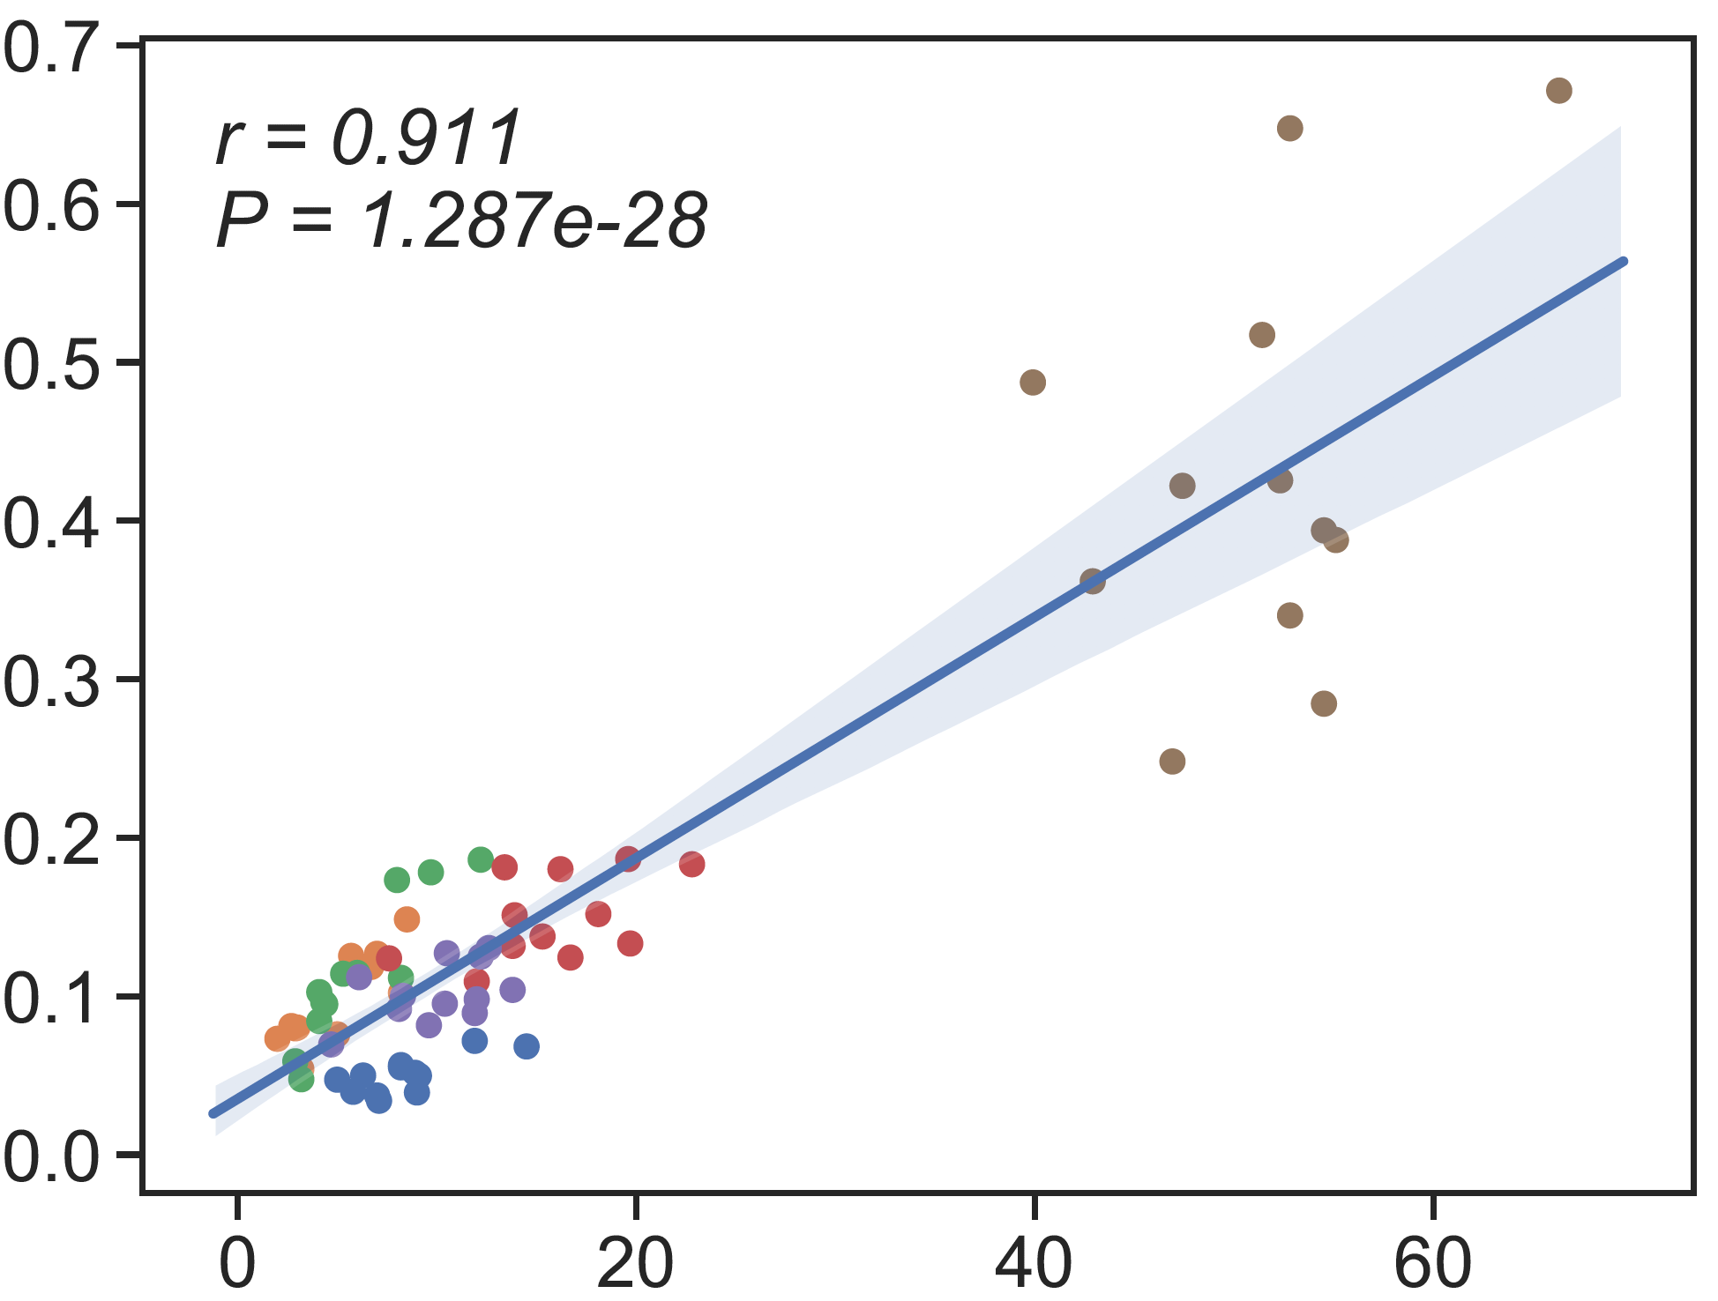
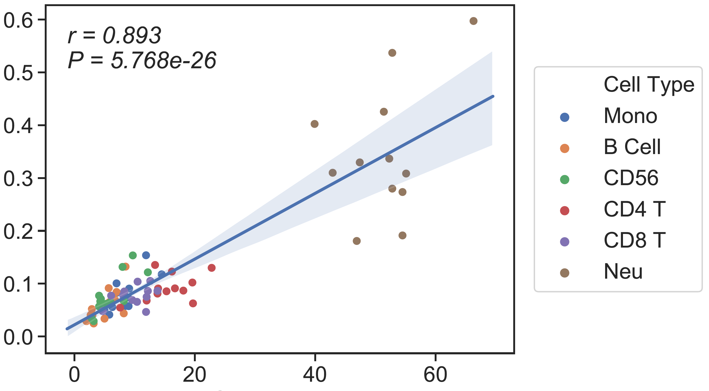
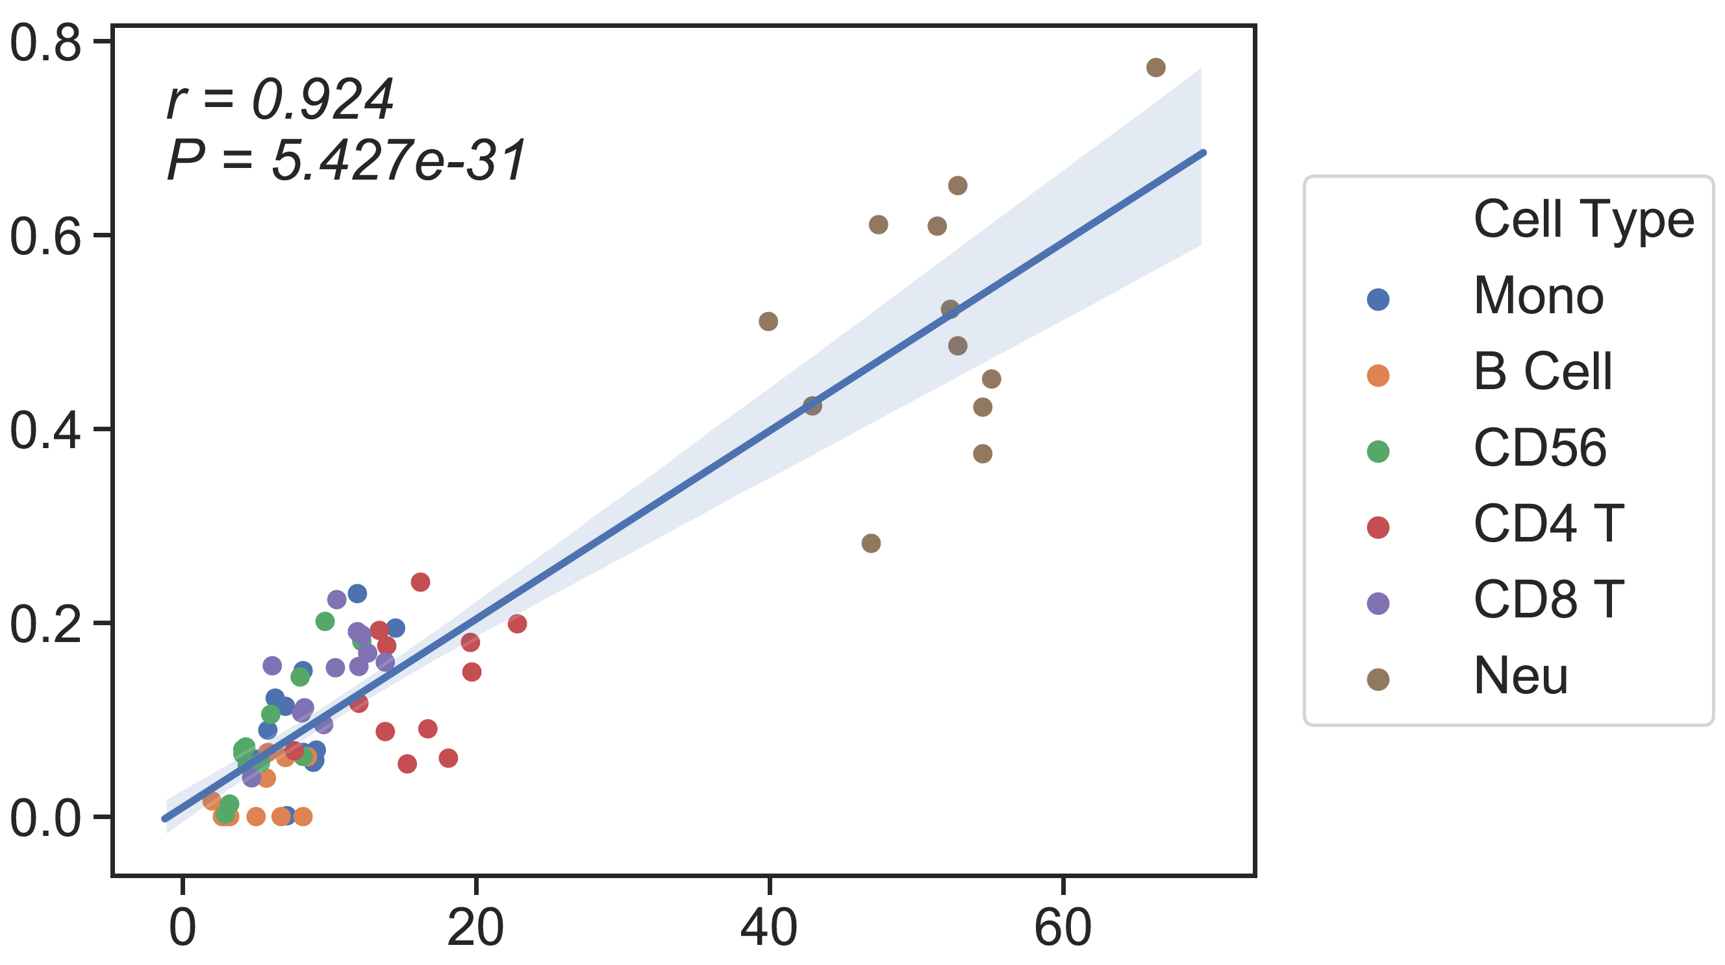
Ground truth: CBC/Clin Flow
CSx on RNA-seq
(LM22)
CBC/Clin Flow
13 cell type Ref
6cell type Ref
Candace’s SM
WGBS
CSx
Absolute Read Counting
rho = 0.73
rho = 0.8
rho = 0.82
CBC/Clin Flow
CBC/Clin Flow
CBC/Clin Flow
Notes:
Bcell=nb+cb

Slide 12
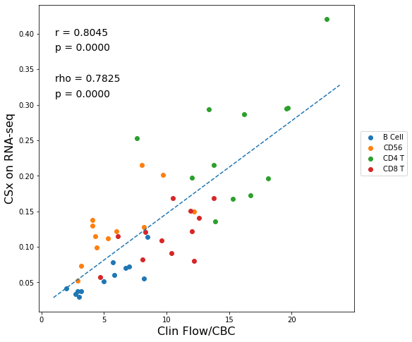
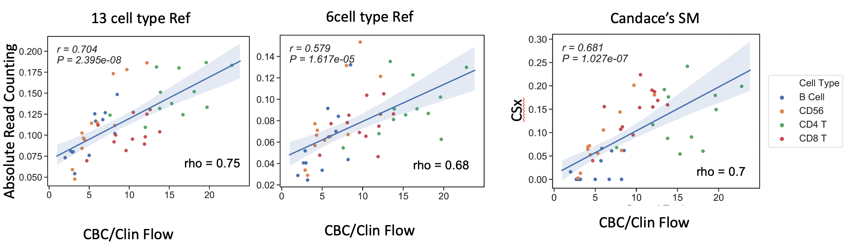
Ground truth: CBC/Clin Flow

Slide 13
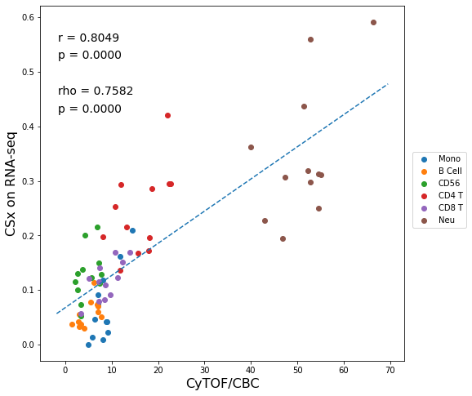
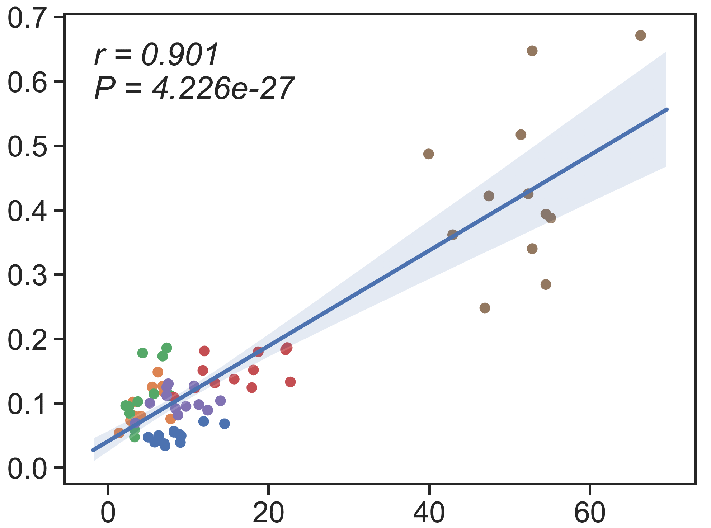
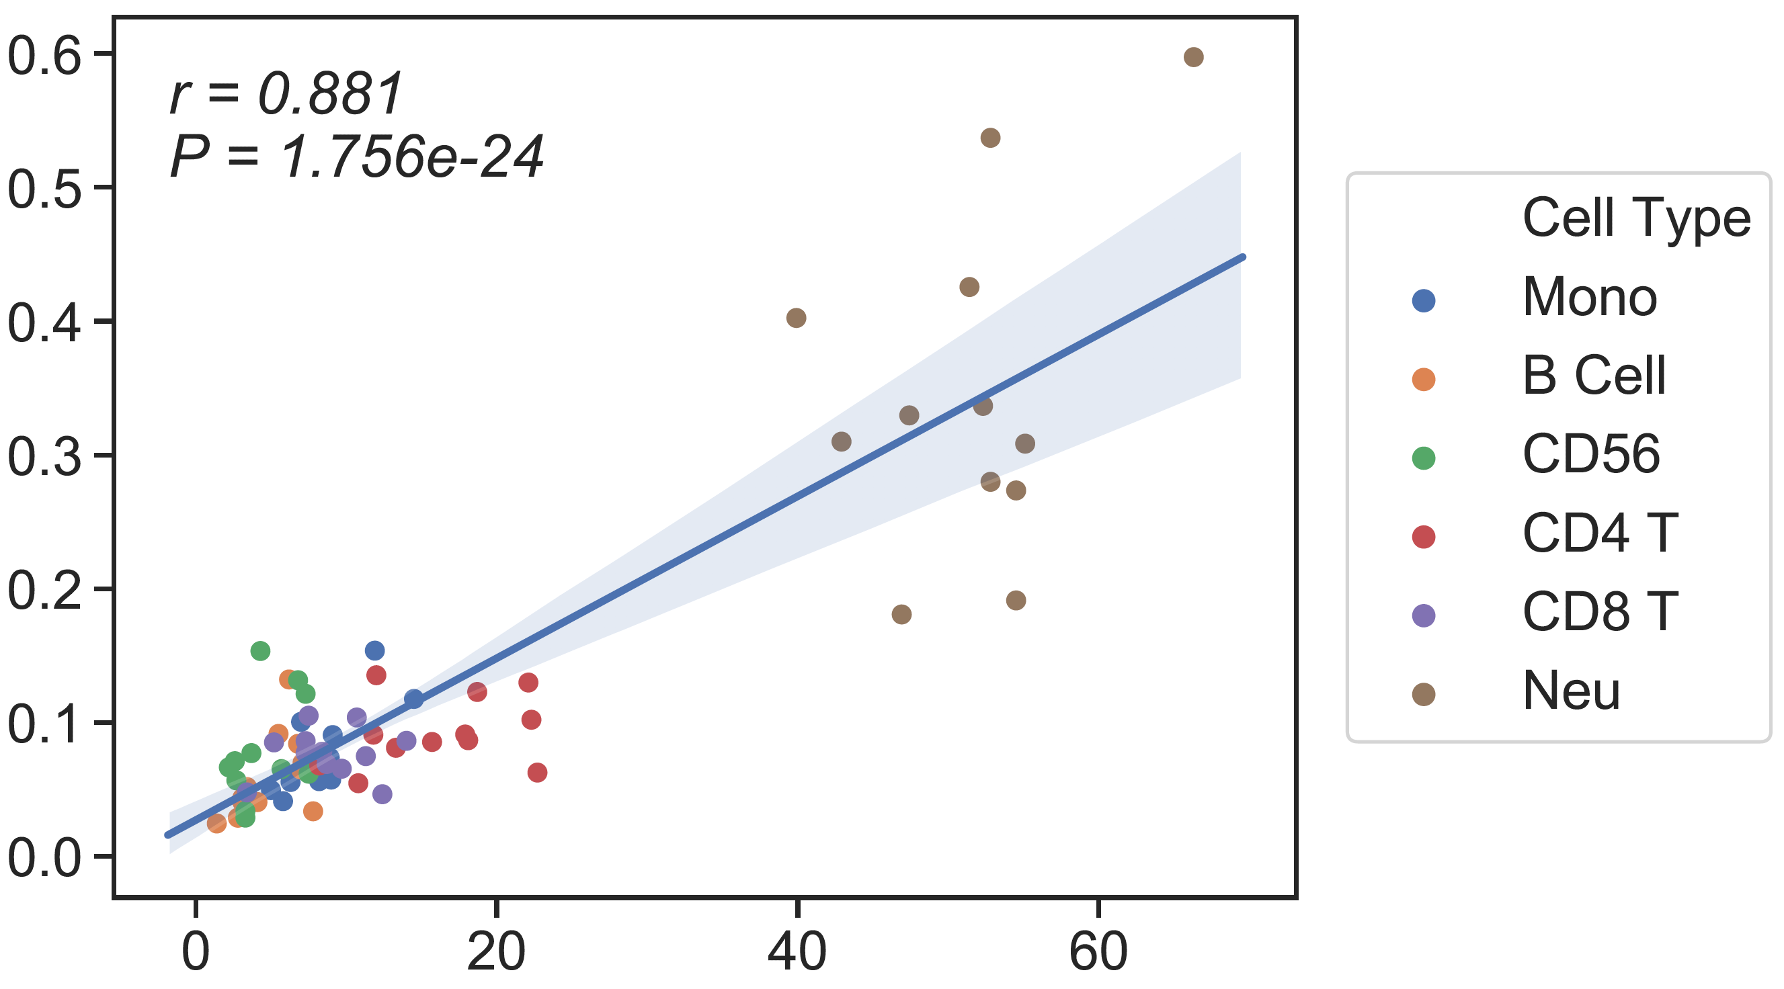
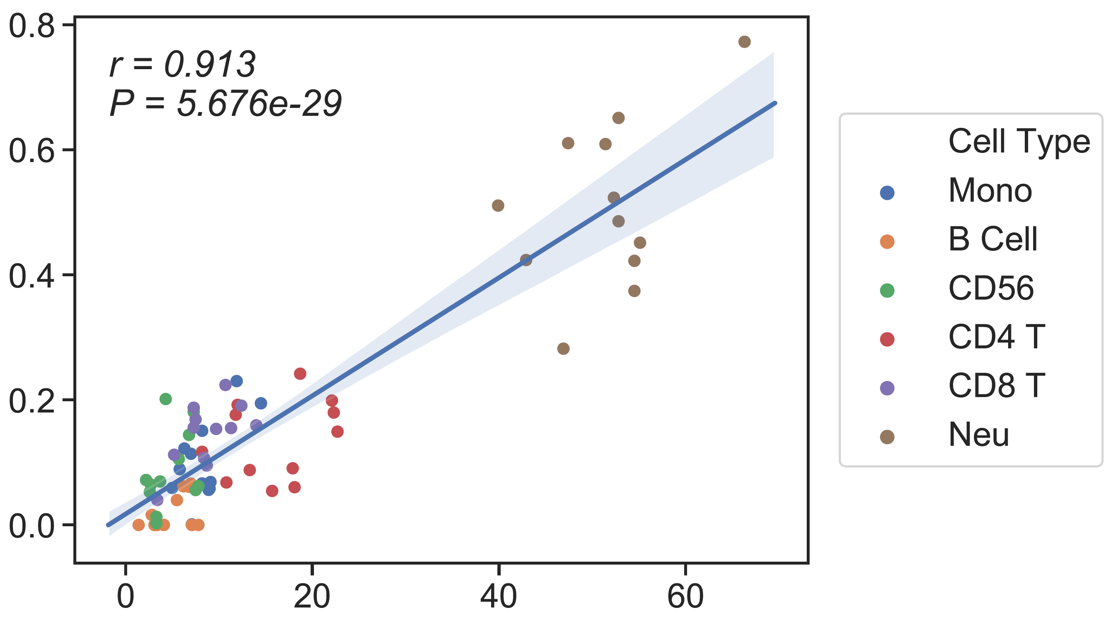
Ground truth: CBC/CyTOF
CSx on RNA-seq
(LM22)
CBC/CyTOF
13 cell type Ref
6cell type Ref
Candace’s SM
WGBS
CSx
Absolute Read Counting
rho = 0.64
rho = 0.7
rho = 0.75
CBC/CyTOF
CBC/CyTOF
CBC/CyTOF
Notes:
Bcell=nb+cb

Slide 14
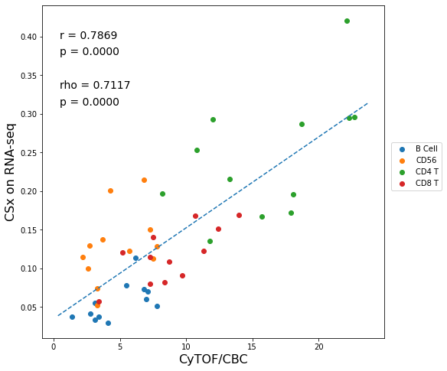
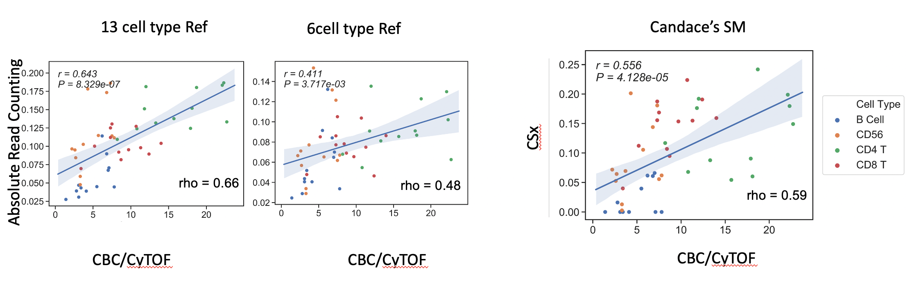
Ground truth: CBC/CyTOF

Slide 15
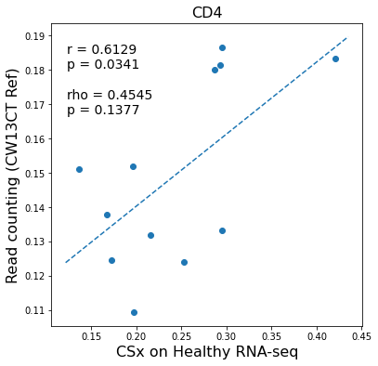
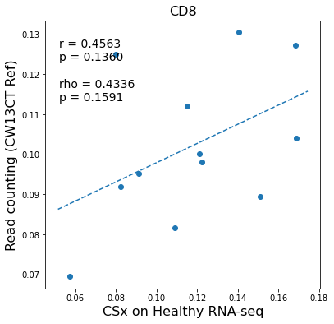
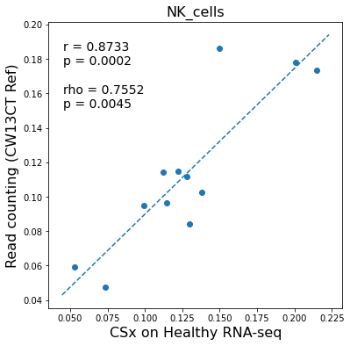
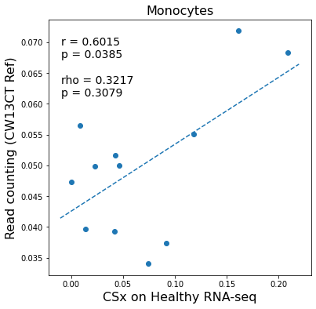
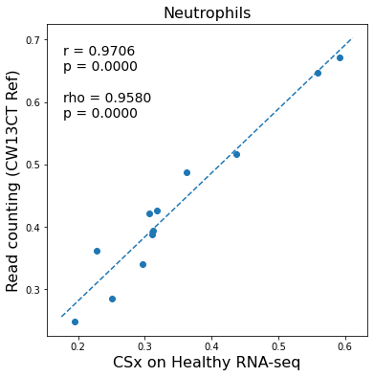
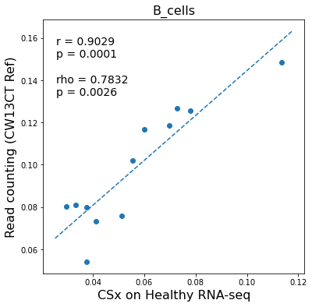
Correlation of 13CT ref on WGBS with CSx on RNA-seq

Slide 16
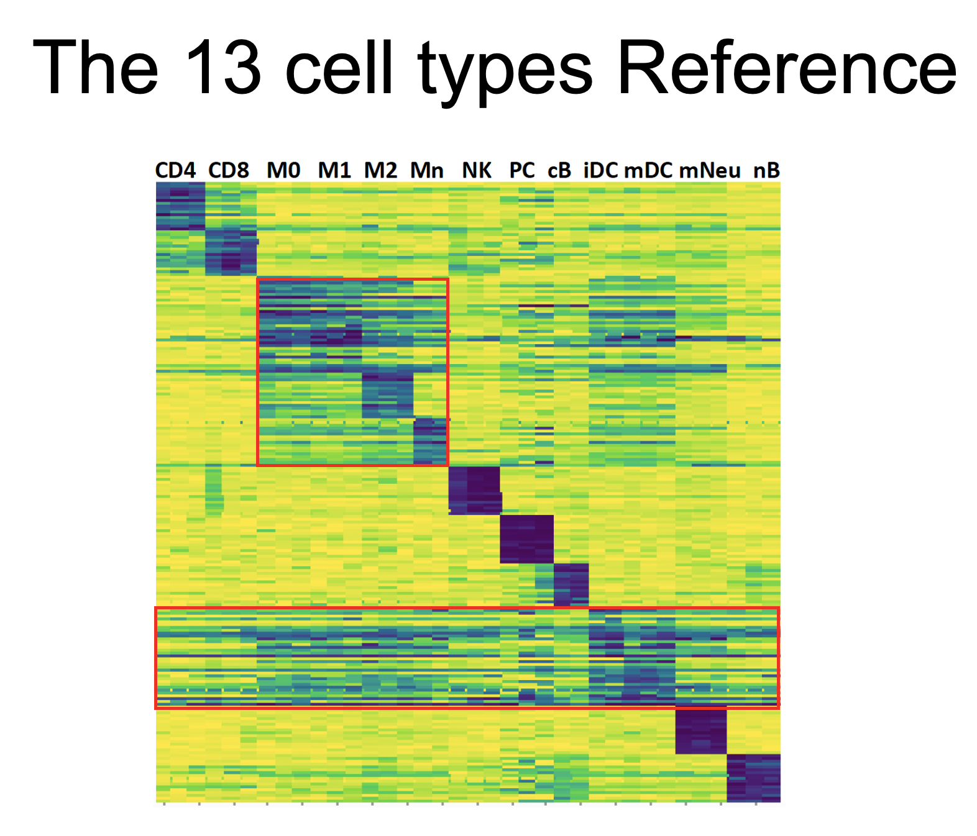

Slide 17
Individual cell type correlation
*both Clin flow and CyTOF are scaled by CBC

Slide 18
QC of cfDNA

Slide 19
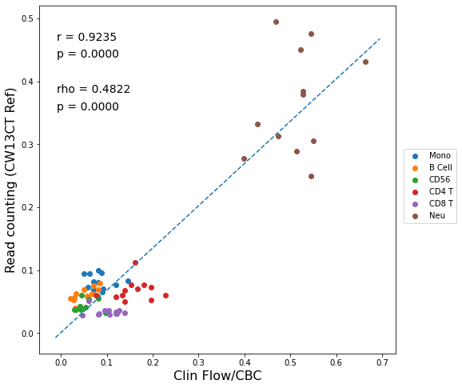
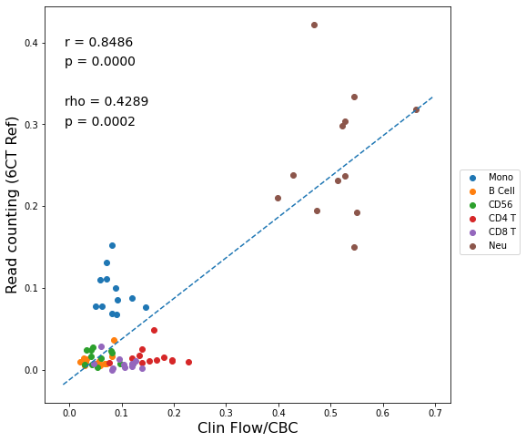
Healthy cfDNA (previous result)
13 cell type Ref
6 cell type Ref
Absolute Read Counting
CBC/Clin Flow
CBC/Clin Flow

Slide 20
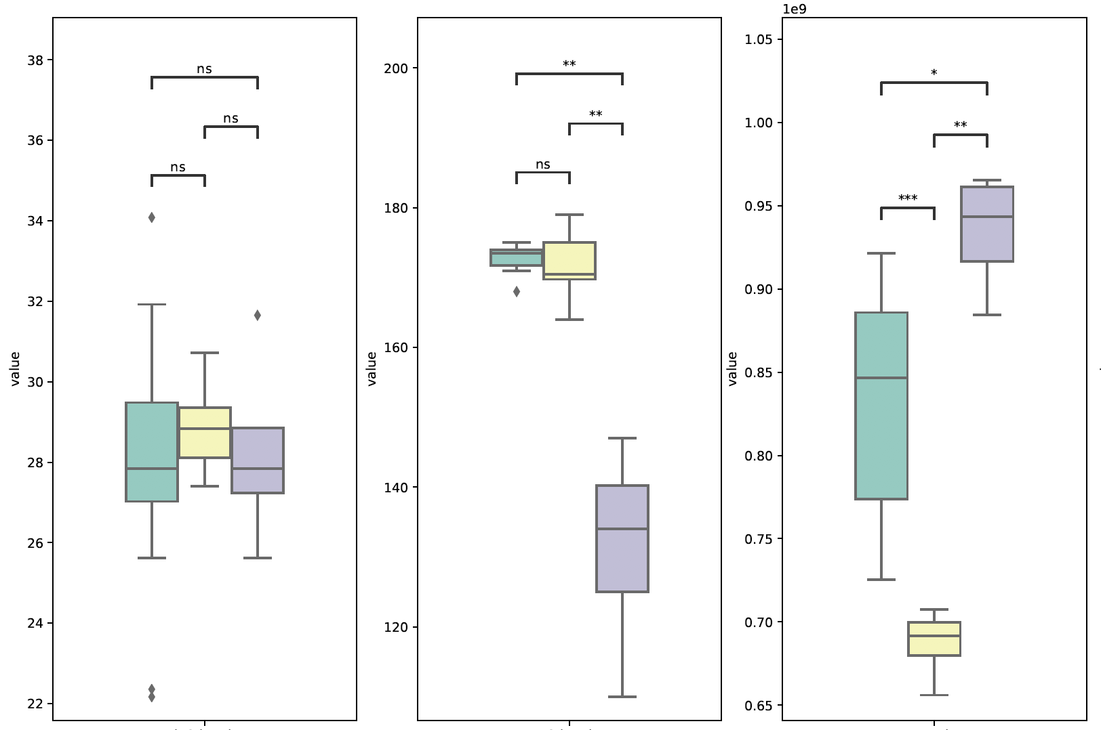
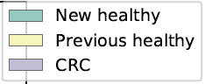
Depth
Fragment Length
#read

Slide 21
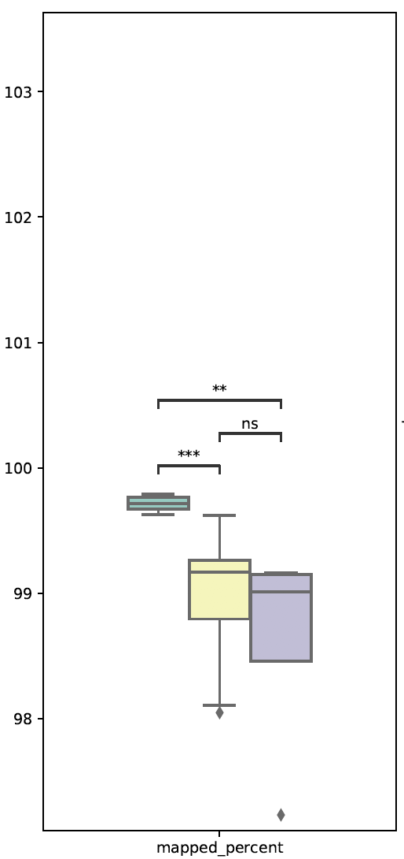
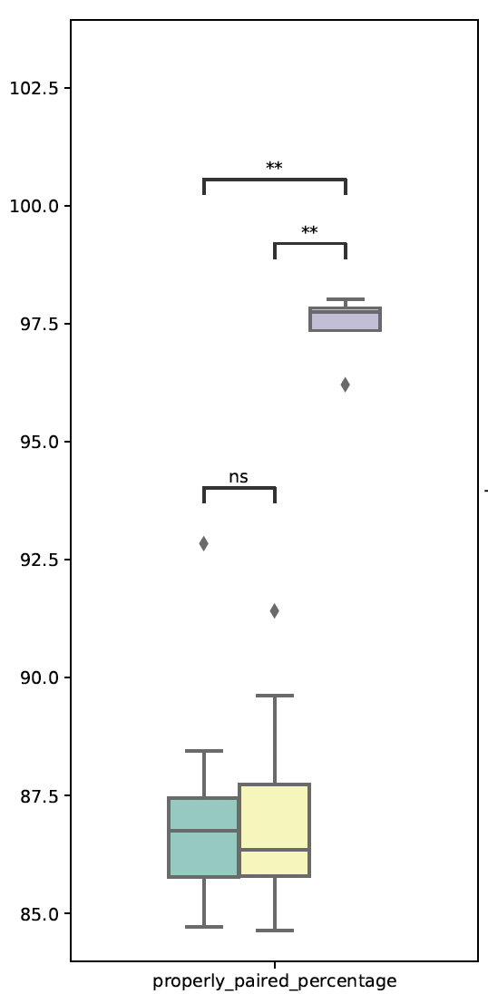
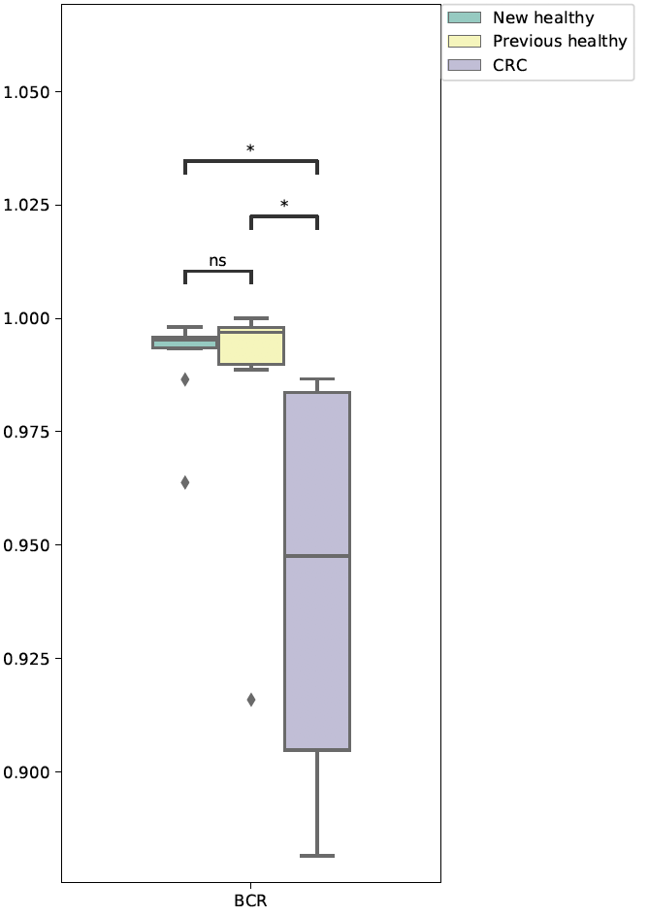
Notes:
BCR=10 million reads

Slide 22
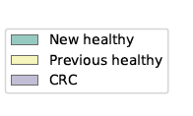
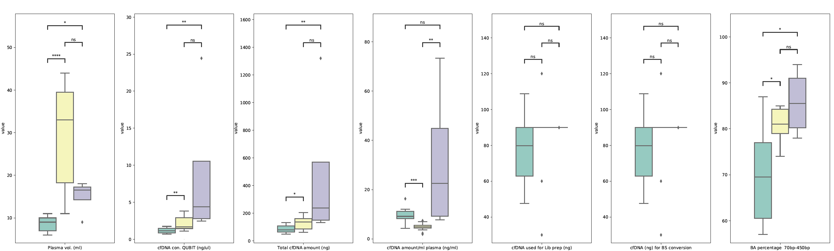

Slide 23
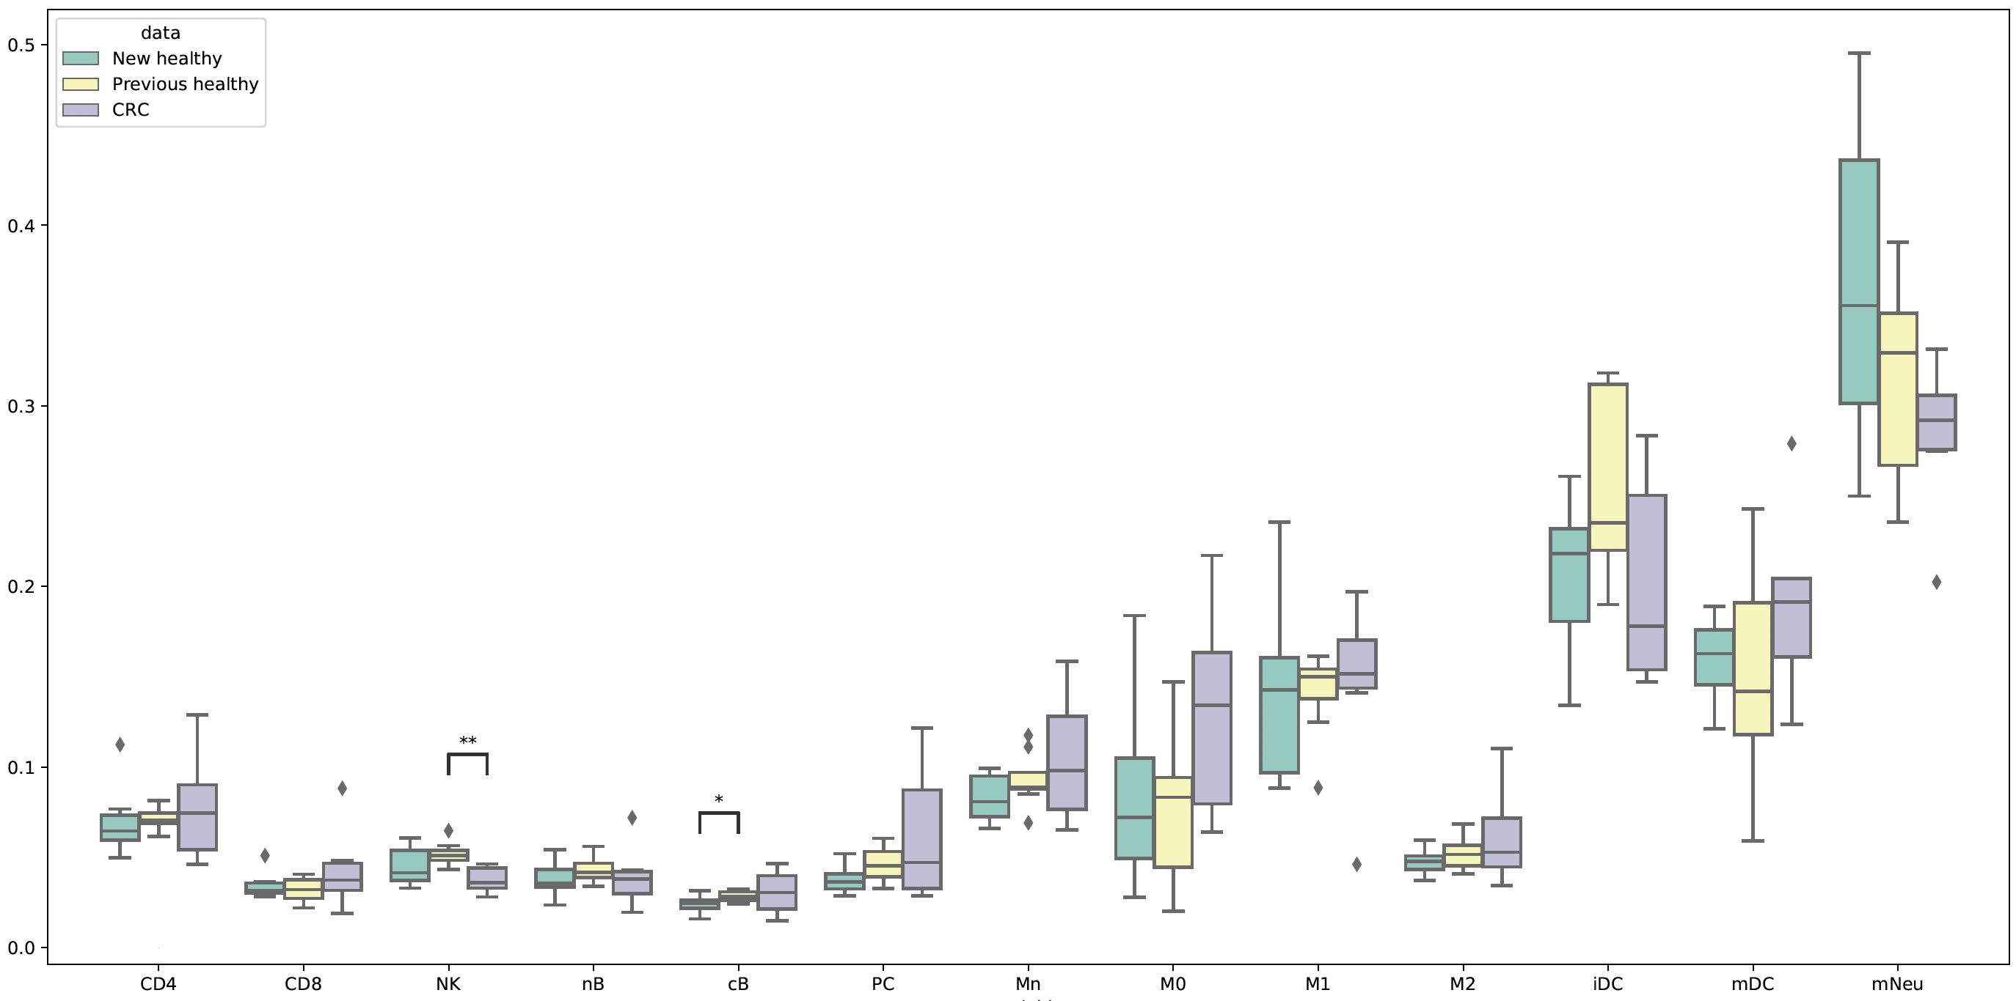
Absolute Read counting
Notes:
6 crc

Slide 24
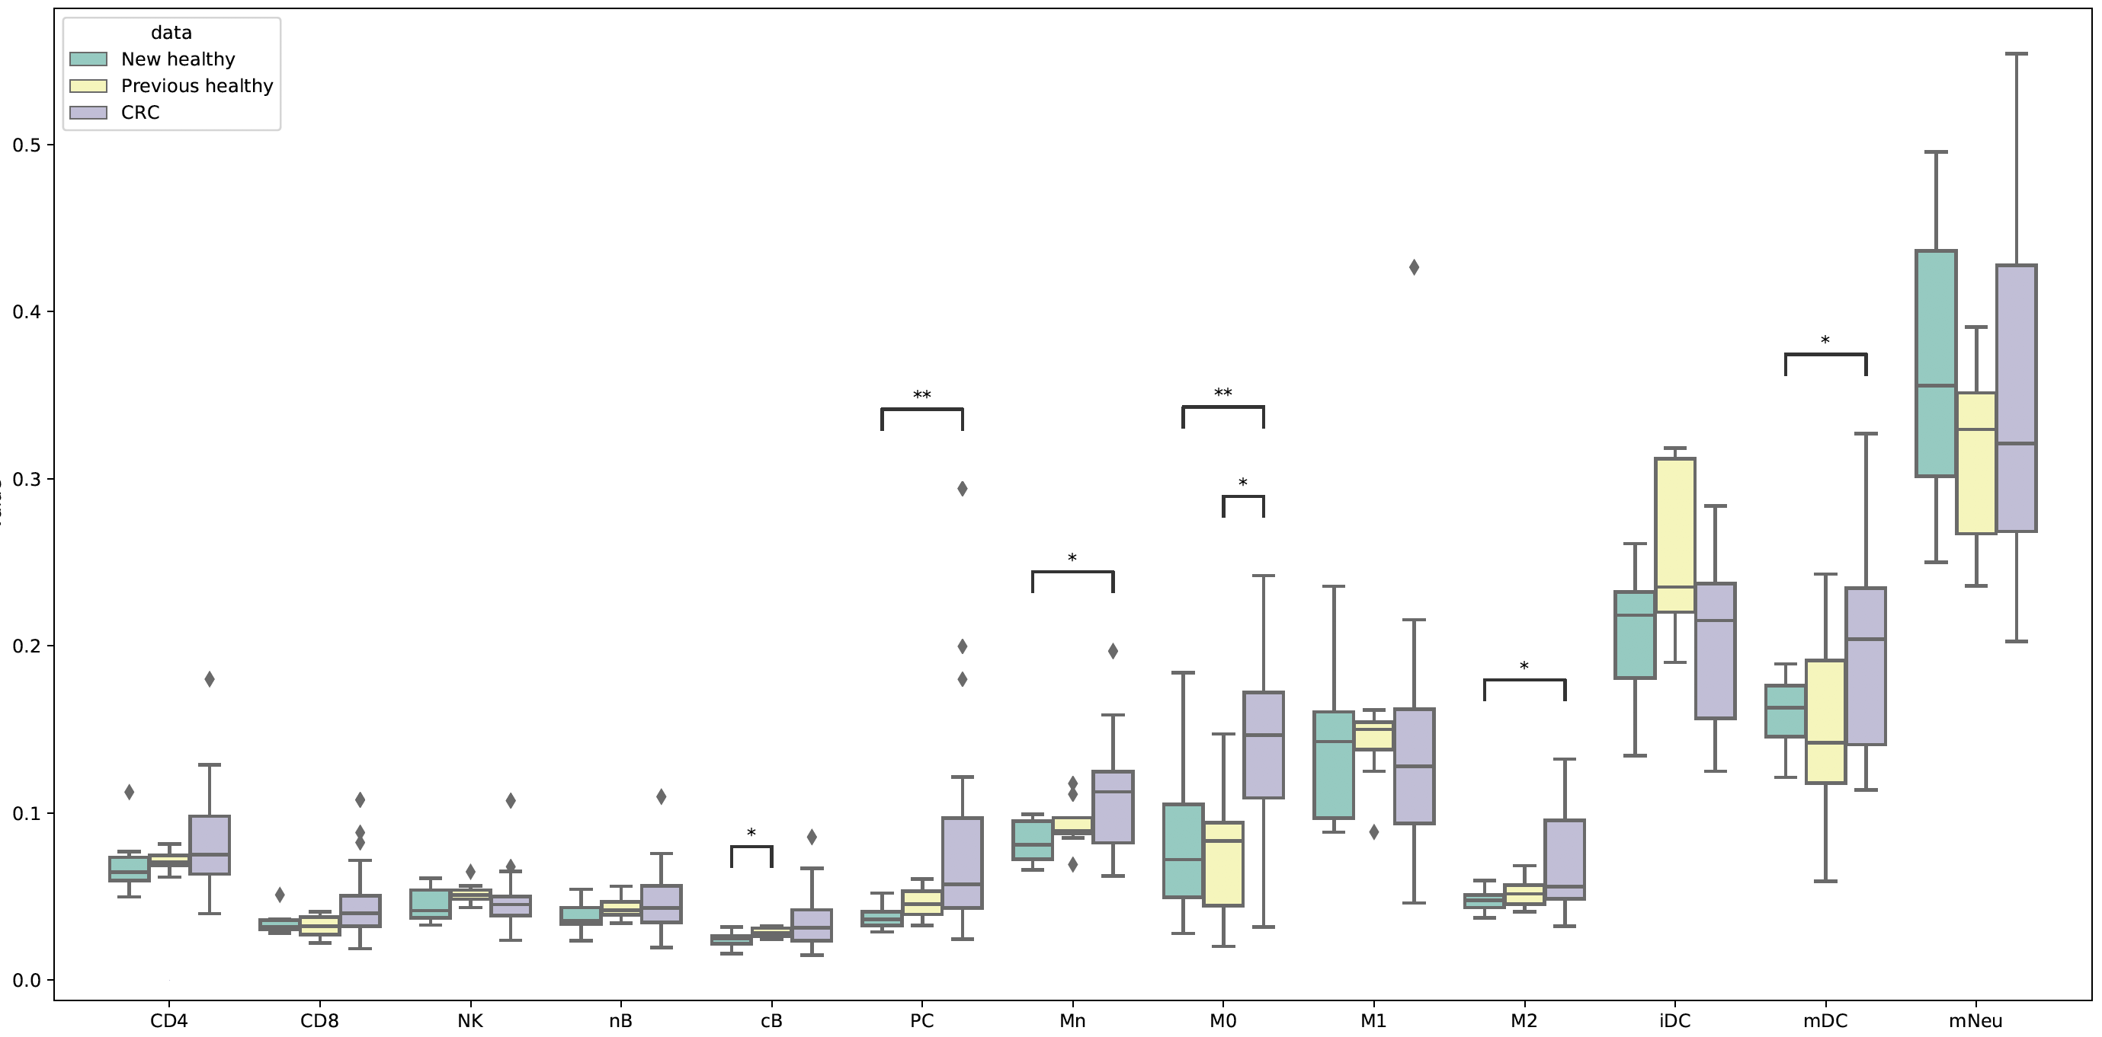
Including “qc failed” CRC (n = 23)
Absolute Read counting

Slide 25
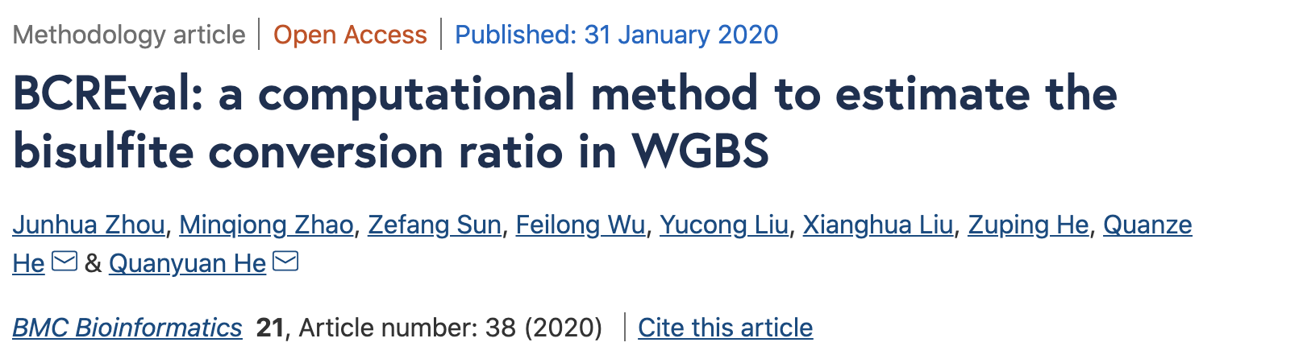

Slide 26
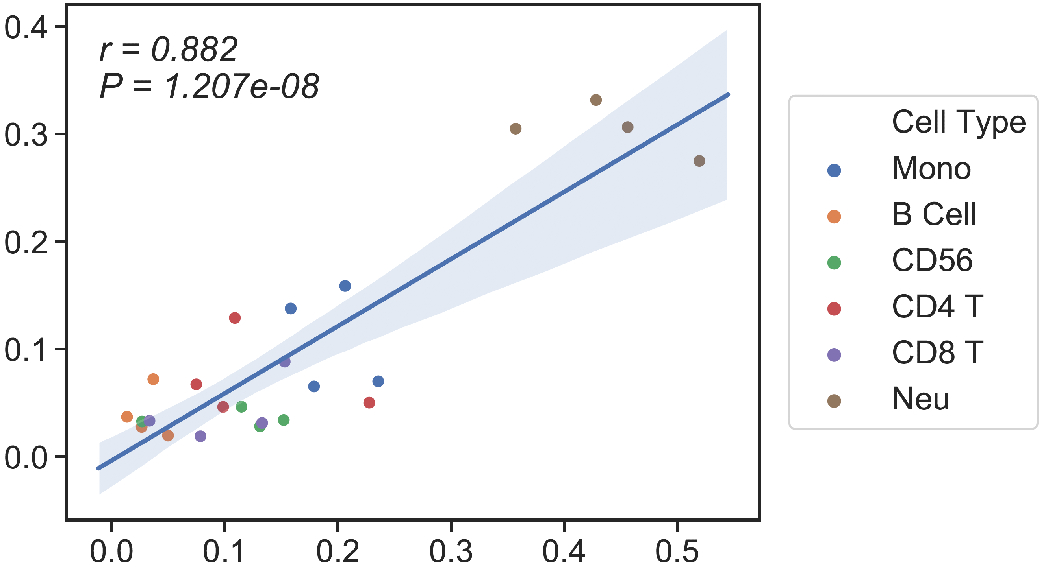
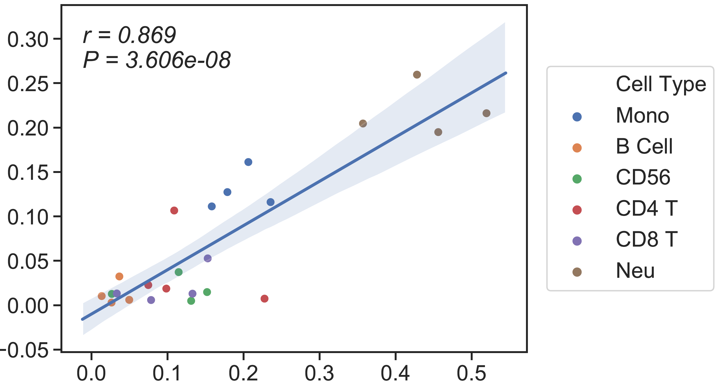
CRC cfDNA (n=4)
13 cell type Ref
6 cell type Ref
Absolute Read Counting
rho = 0.71
rho = 0.74
CBC-Flow cytometry
CBC-Flow cytometry
Notes:
Qcpass4+prrev2

Slide 27
Diagnosis of 13 cell types reference

Slide 29
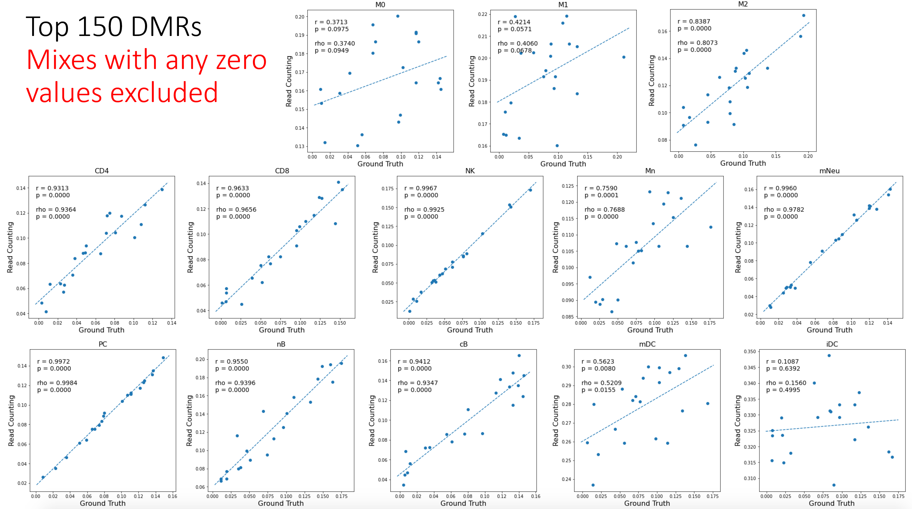
In Silico performance

Slide 30
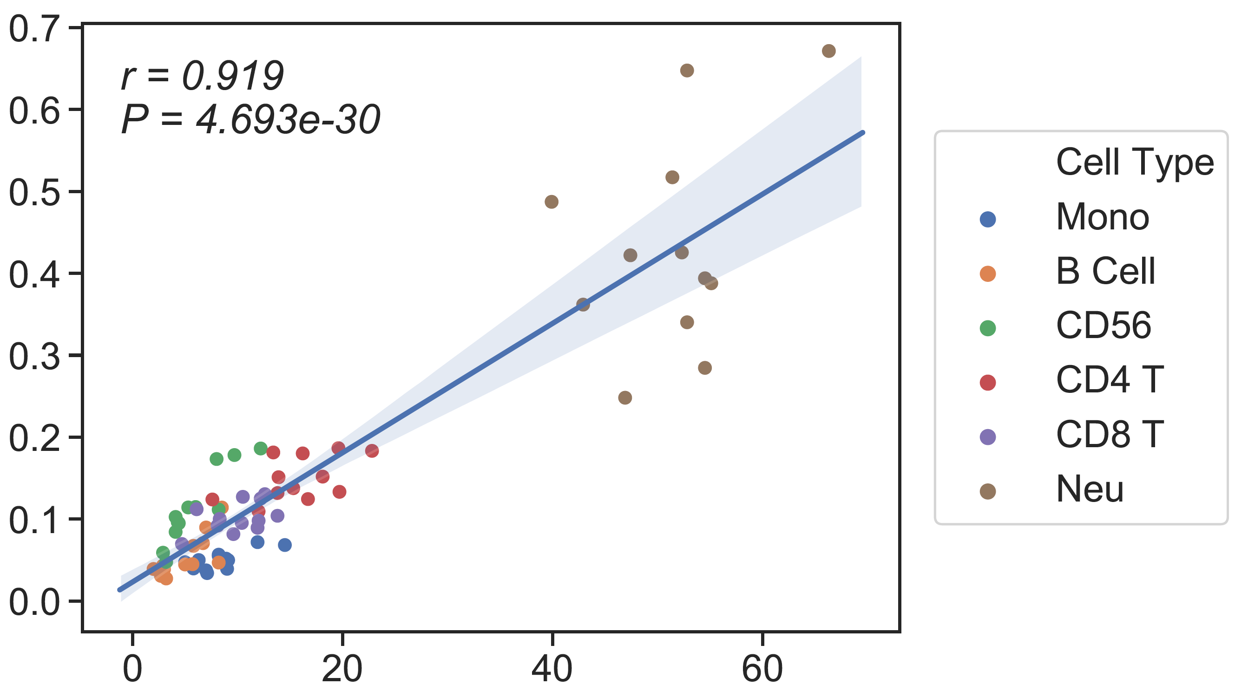
WB (previous result)
Ground truth: CBC/Clin Flow
13 cell type Ref
6cell type Ref
Candace’s SM
CSx
Absolute Read Counting
rho = 0.81
rho = 0.8
rho = 0.82
CBC/Clin Flow
CBC/Clin Flow
CBC/Clin Flow

Slide 31
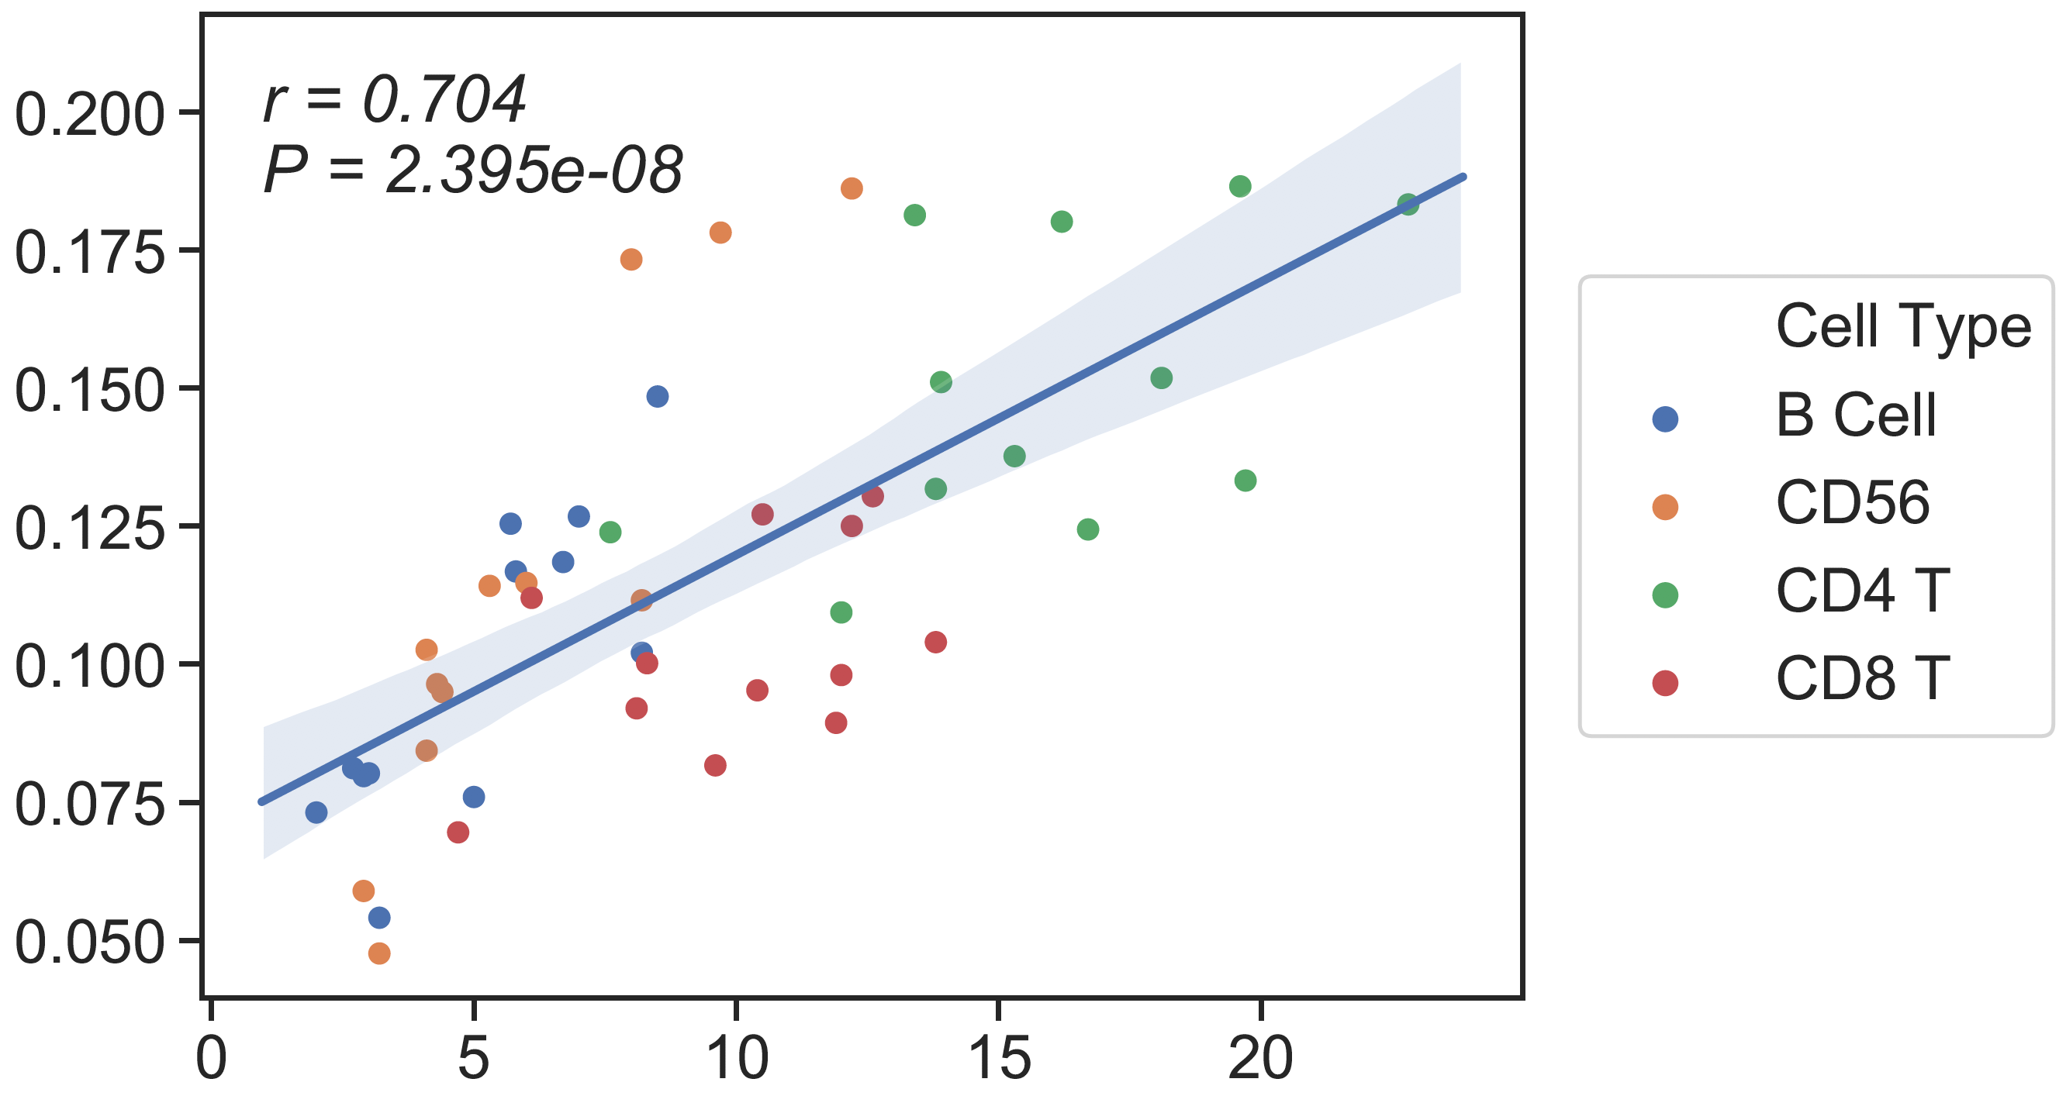
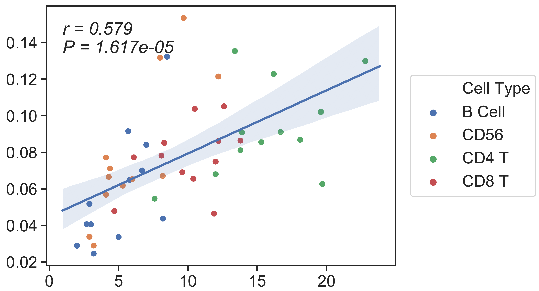
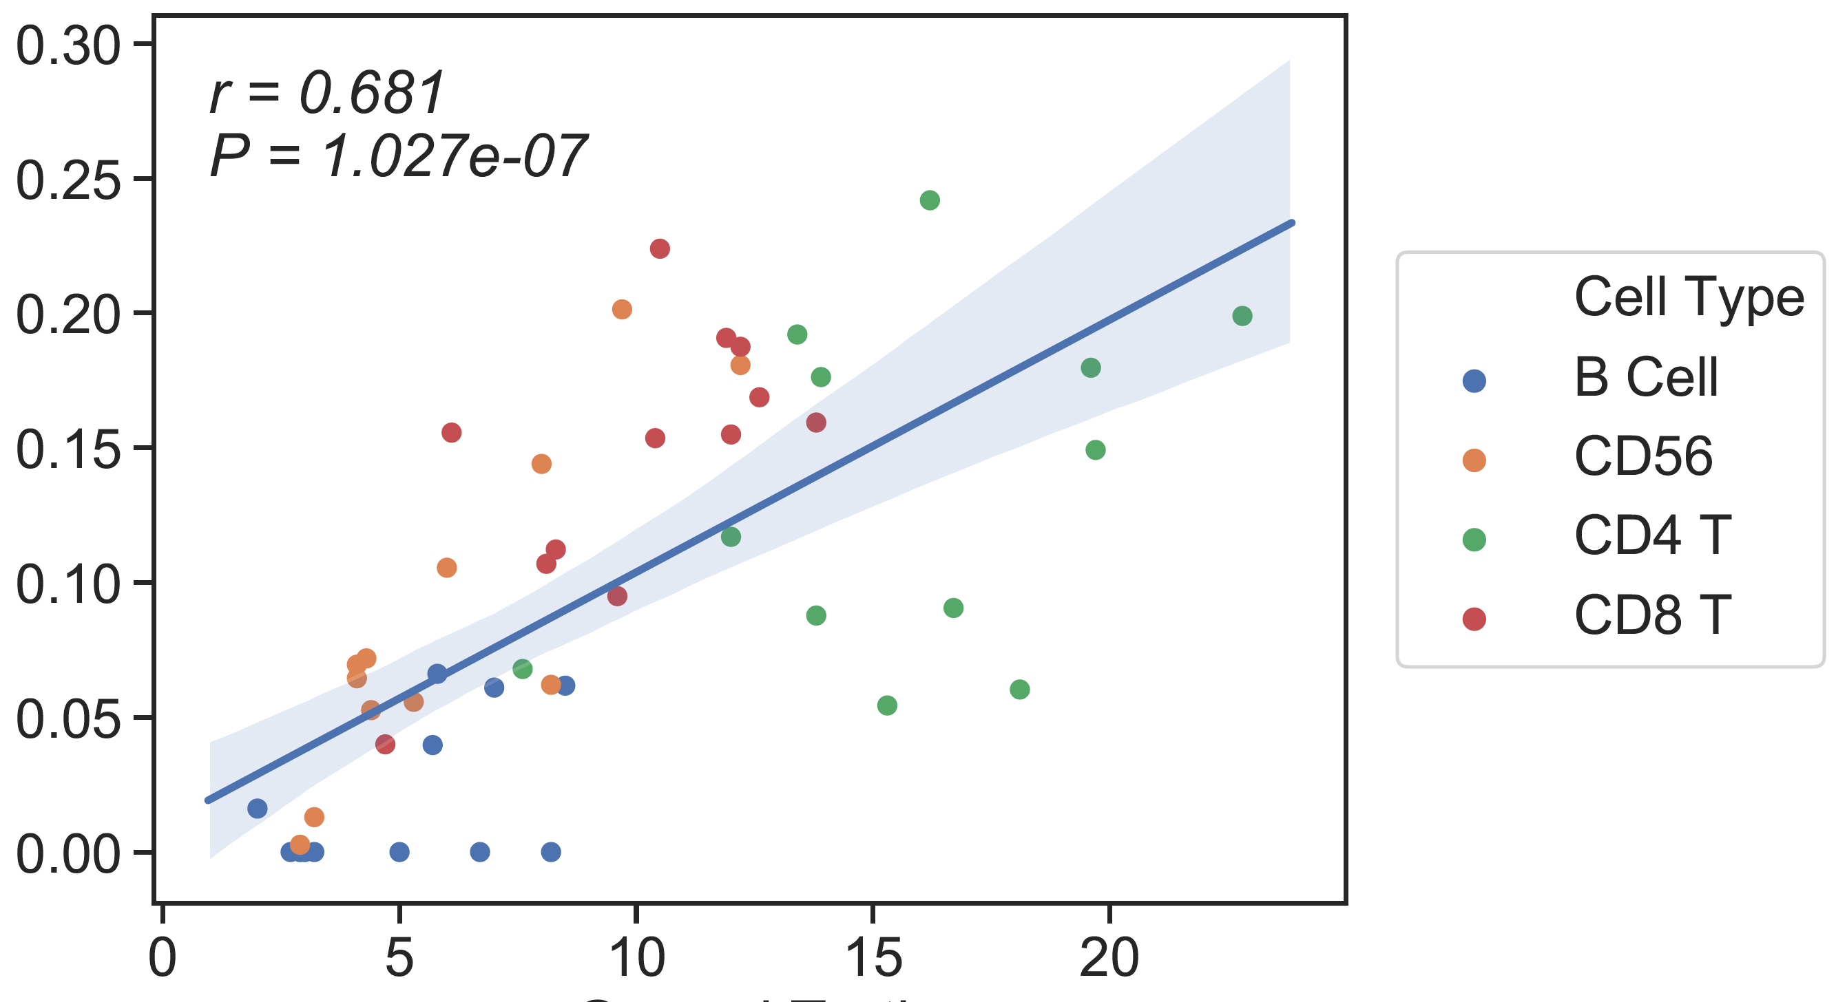
CBC/Clin Flow
13 cell type Ref
6cell type Ref
Candace’s SM
Absolute Read Counting
CSx
rho = 0.75
rho = 0.68
rho = 0.7
CBC/Clin Flow
CBC/Clin Flow
CBC/Clin Flow
Notes:
13 ct ref: B cell=nb+cb

Slide 32
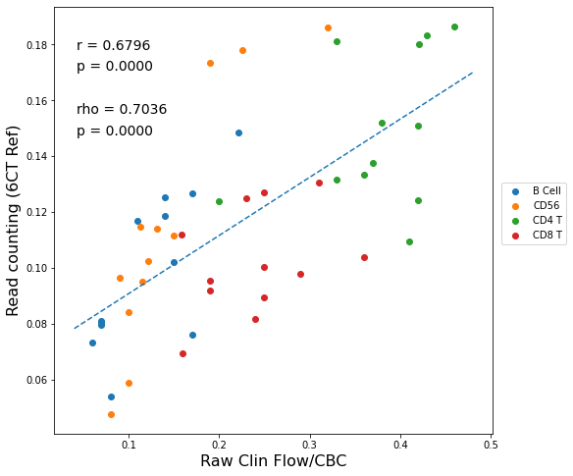
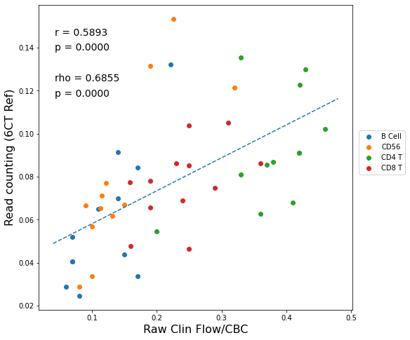
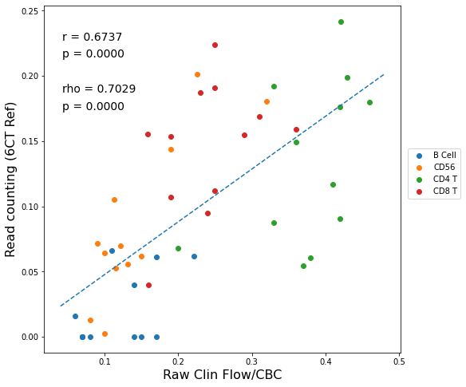
Clin Flow
13 cell type Ref
6cell type Ref
Candace’s SM
CSx
Absolute Read Counting
Clin Flow
Clin Flow
Clin Flow
Notes:
13 ct ref: B cell=nb+cb

Slide 33
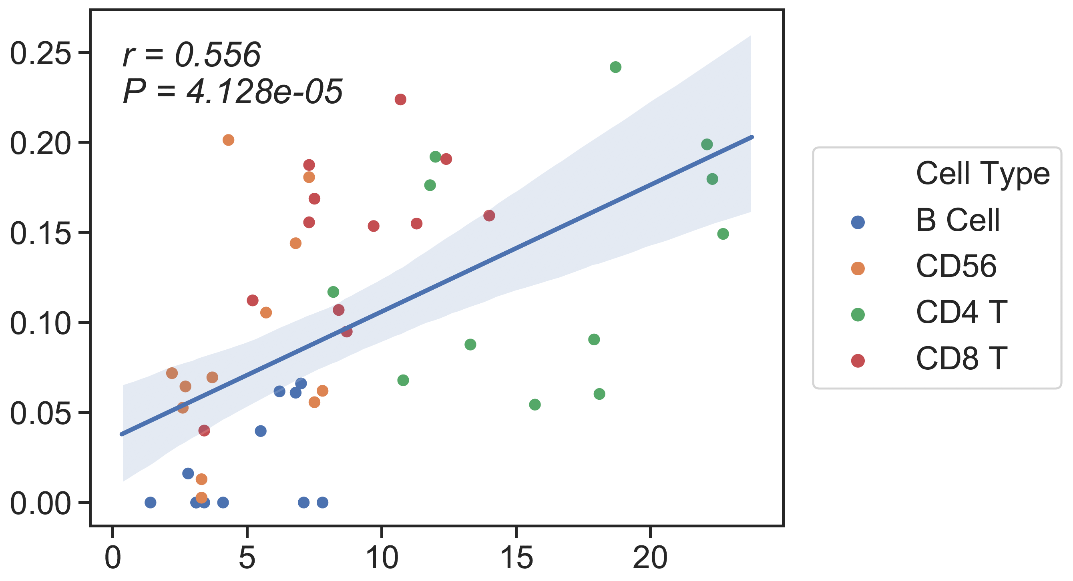
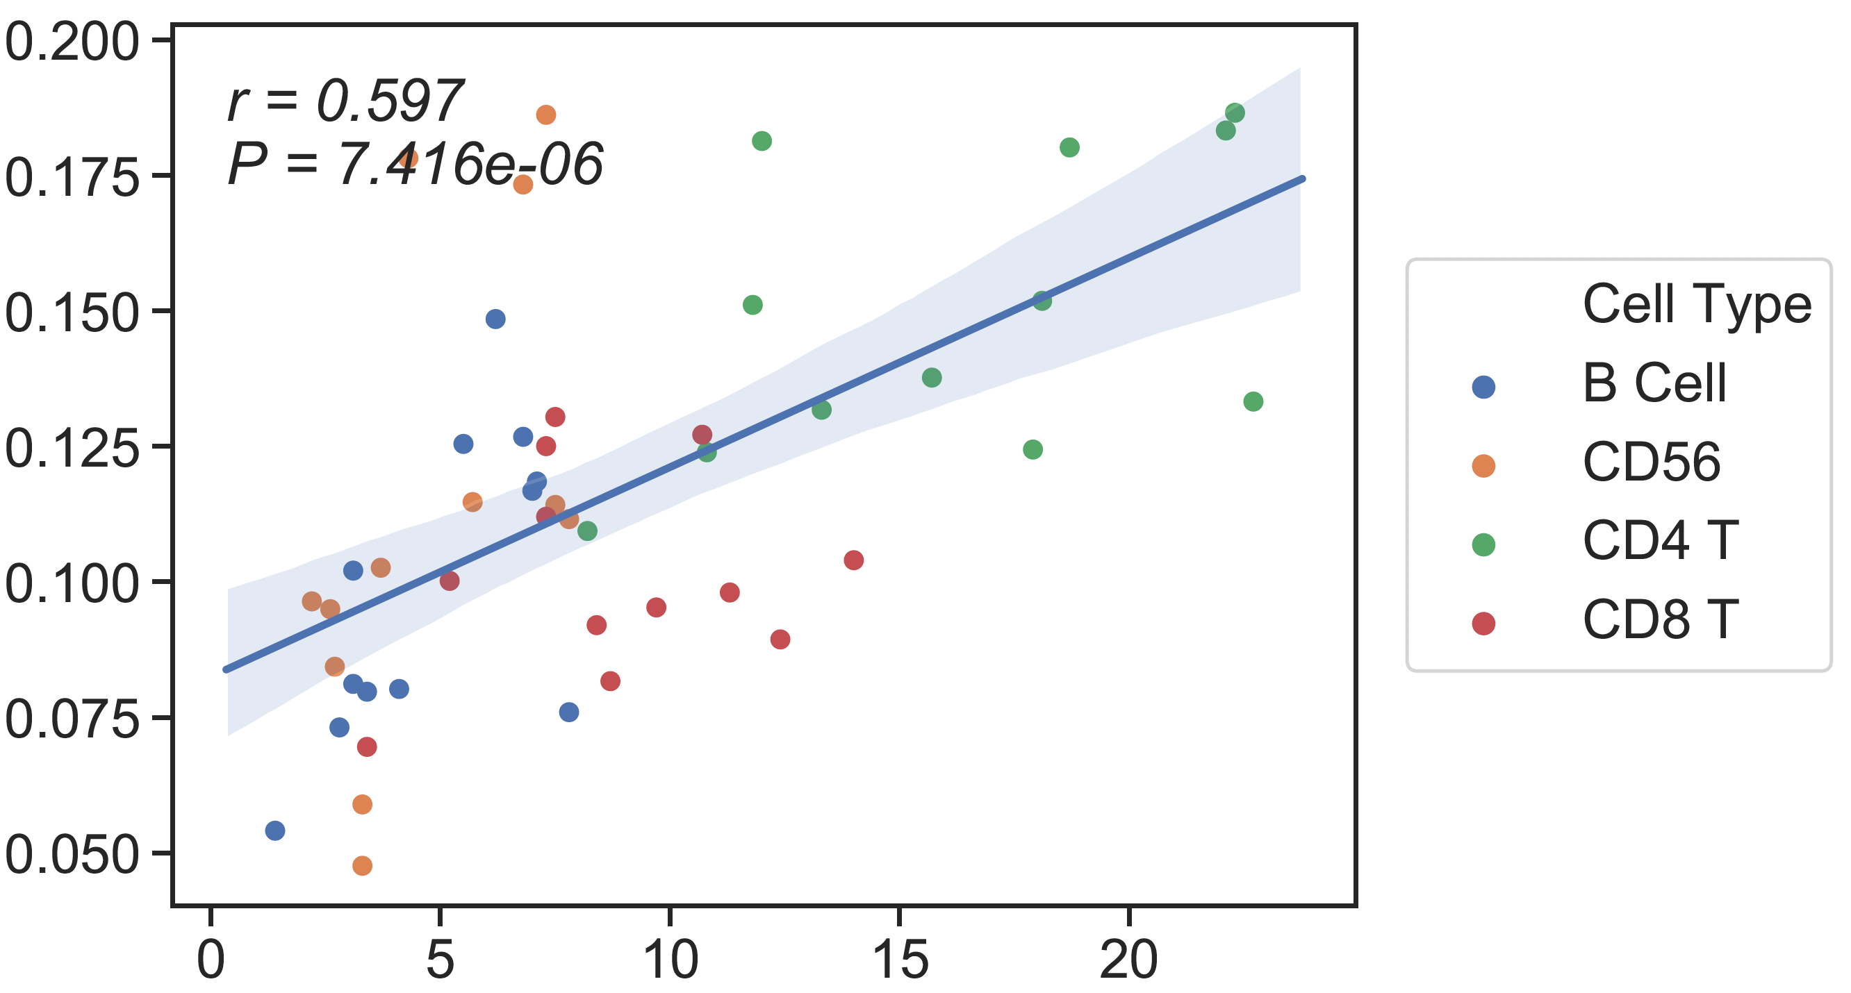
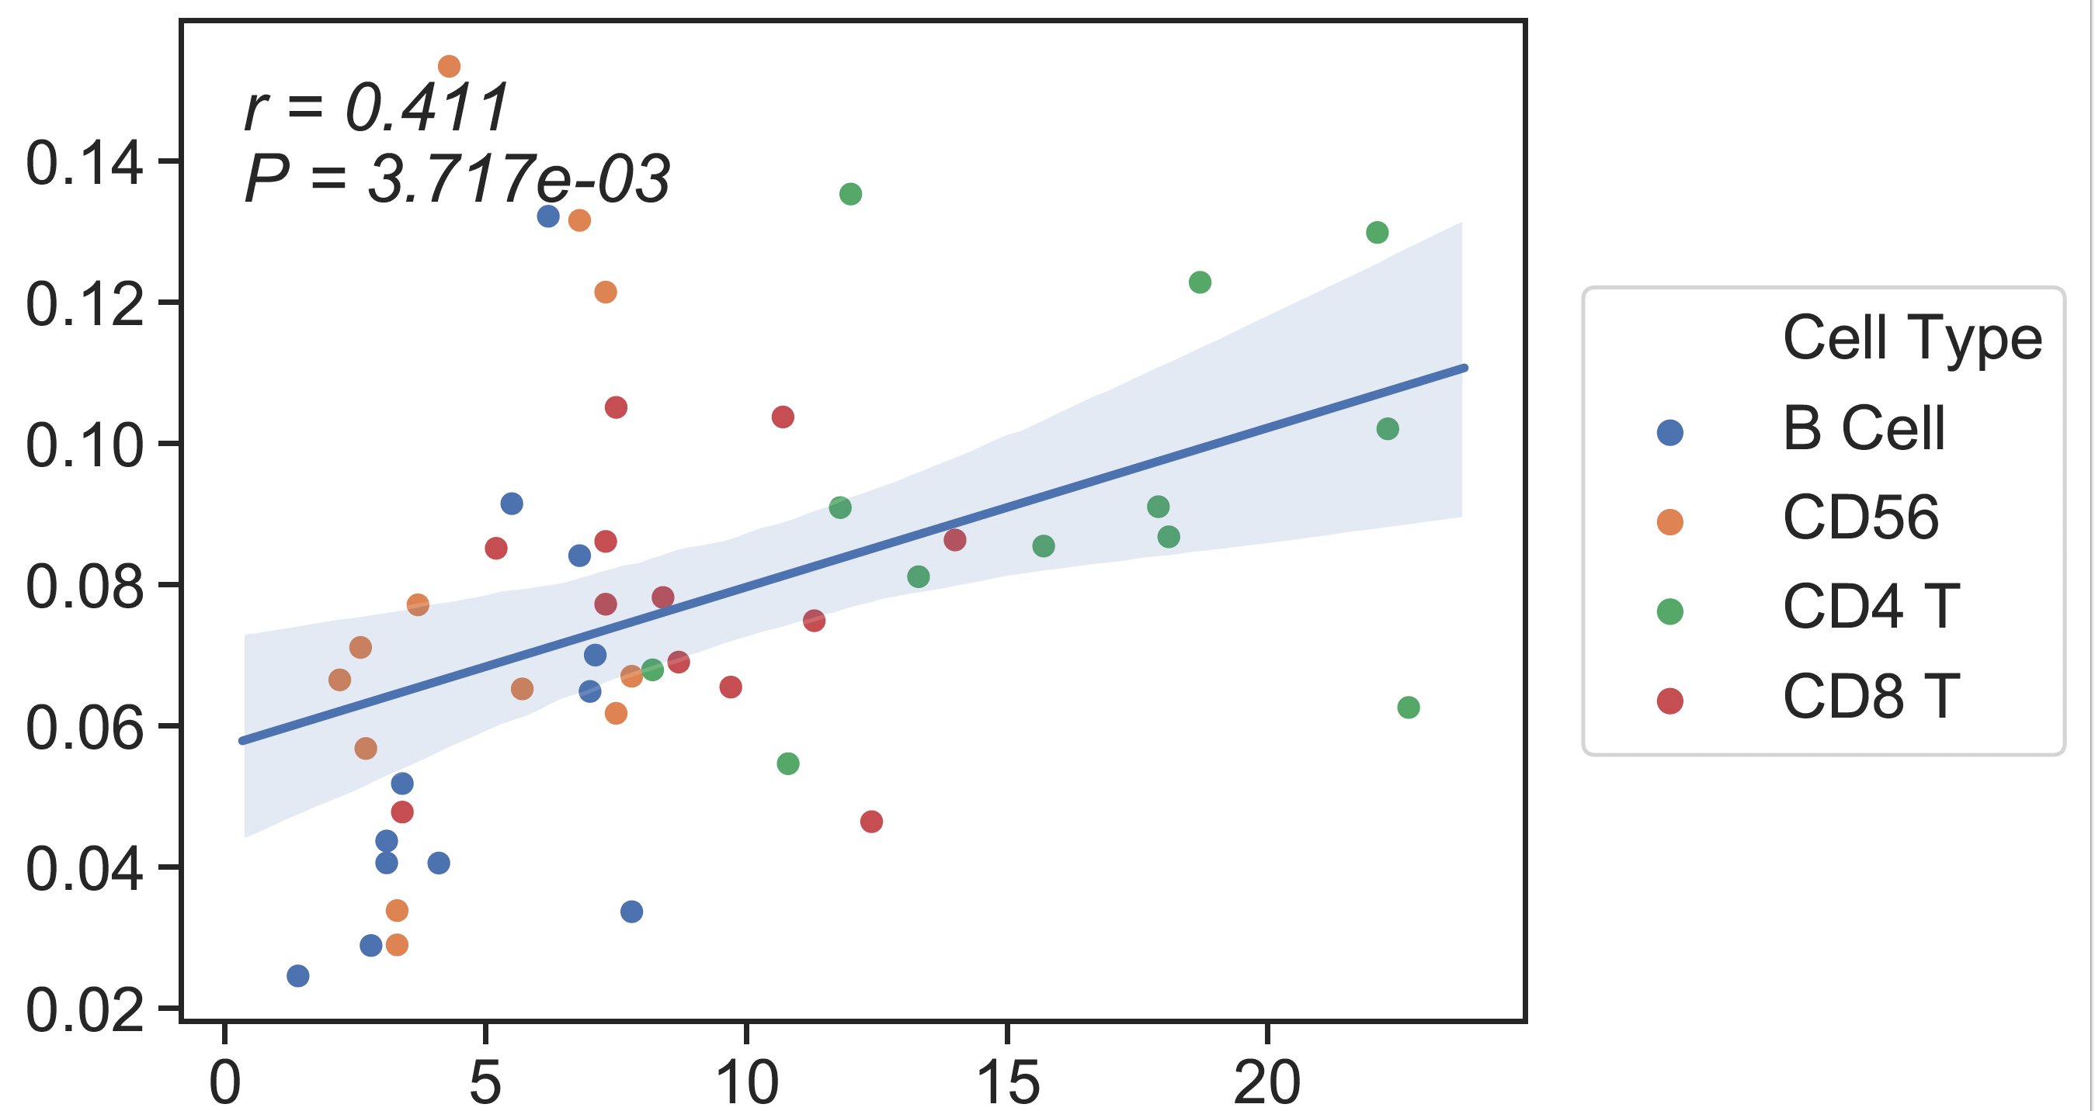
CBC/CyTOF
13 cell type Ref
6cell type Ref
Candace’s SM
Absolute Read Counting
CSx
rho = 0.596
rho = 0.48
rho = 0.59
CBC/CyTOF
CBC/CyTOF
CBC/CyTOF
Notes:
13 ct ref: B cell=nb+cb

Slide 34
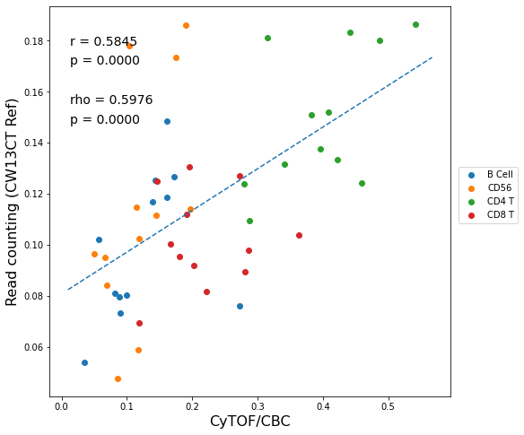


CyTOF
13 cell type Ref
6cell type Ref
Candace’s SM
Absolute Read Counting
CSx
CyTOF
CyTOF
CyTOF
Notes:
13 ct ref: B cell=nb+cb

Slide 37
Test on previous data

Slide 38
WB (previous result)
13 cell type Ref
6cell type Ref
Absolute Read Counting
rho = 0.81
rho = 0.8
CBC/Clin Flow
CBC/Clin Flow

Slide 39
Healthy cfDNA (new data, n=12)
13 cell type Ref
6 cell type Ref
Absolute Read Counting
CBC/Clin Flow
CBC/Clin Flow

Slide 40




Performance of 6 cell types and 13 cell types reference (Absolute read counting)
Batch1: Bulk PBMC (CRC)
(input ~ 25ng)
Batch2 : Bulk PBMC (SKCM)
(input ~ 100ng)
13 cell types reference
rho = 0.51
rho= 0.67
6 cell types reference
rho = 0.89
rho= 0.95
Flow cytometry
Flow cytometry
Notes:
perfectrejcode

Slide 41


Performance of 6 cell types and 13 cell types reference (Absolute read counting)
Batch1: Bulk PBMC (CRC)
(input ~ 25ng)
Batch1 : cfDNA (CRC)
(input ~ 30ng)
13 cell types reference
rho = 0.85
rho = 0.51
6 cell types reference
rho = 0.89
rho = 0.93
Flow cytometry
CBC-Flow cytometry
Notes:
perfectrejcode

Slide 42


CRC cfDNA (n=6)
13 cell type Ref
6 cell type Ref
Absolute Read Counting
rho = 0.74
rho = 0.77
CBC-Flow cytometry
CBC-Flow cytometry
Notes:
Qcpass4+prrev2

Slide 43
Healthy cfDNA (new data, n=12)
13 cell type Ref
6 cell type Ref
Absolute Read Counting
CBC/Clin Flow
CBC/Clin Flow

Slide 44
Blueprint samples genomic features

Slide 45


Mono, M0,M1, M2

Slide 46

CD14 promoter
CD4
CD8
nB
cB
NK
PC
Mn
M0
M1
M2
iDC
mDC
mNeu

Slide 47

CD42b (GP1BA) promoter
CD4
CD8
nB
cB
NK
PC
Mn
M0
M1
M2
iDC
mDC
mNeu

Slide 48

CD64 (FCGR1A) promoter
CD4
CD8
nB
cB
NK
PC
Mn
M0
M1
M2
iDC
mDC
mNeu

Slide 49

CD45 (PTPRC) promoter
CD4
CD8
nB
cB
NK
PC
Mn
M0
M1
M2
iDC
mDC
mNeu

Slide 50

CD206 (MRC1) promoter
CD4
CD8
nB
cB
NK
PC
Mn
M0
M1
M2
iDC
mDC
mNeu

Slide 51

CD68
promoter
CD4
CD8
nB
cB
NK
PC
Mn
M0
M1
M2
iDC
mDC
mNeu

Slide 52

CD163
promoter
CD4
CD8
nB
cB
NK
PC
Mn
M0
M1
M2
iDC
mDC
mNeu

Slide 53

APOE
promoter
CD4
CD8
nB
cB
NK
PC
Mn
M0
M1
M2
iDC
mDC
mNeu

Slide 54

CCR2
promoter
CD4
CD8
nB
cB
NK
PC
Mn
M0
M1
M2
iDC
mDC
mNeu

Slide 55

CSF1R
promoter
CD4
CD8
nB
cB
NK
PC
Mn
M0
M1
M2
iDC
mDC
mNeu

Slide 56


19 CT reference

Slide 57
Diagnosis of 13 cell types reference

Slide 59
In Silico performance

Slide 60
WB (previous result)
Ground truth: CBC/Clin Flow
13 cell type Ref
6cell type Ref
Candace’s SM
CSx
Absolute Read Counting
rho = 0.81
rho = 0.8
rho = 0.82
CBC/Clin Flow
CBC/Clin Flow
CBC/Clin Flow

Slide 61

cfDNA
Ground truth: CBC/Clin Flow
13 cell type Ref
6 cell type Ref
Candace’s SM
Absolute Read Counting
CSx
CBC/Clin Flow
CBC/Clin Flow
CBC/Clin Flow

Slide 62



WB (previous result)
Ground truth: CBC/Clin Flow without Mono
13 cell type Ref
6cell type Ref
Candace’s SM
CSx
Absolute Read Counting
rho = 0.89
rho = 0.83
rho = 0.84
CBC/Clin Flow
CBC/Clin Flow
CBC/Clin Flow

Slide 63



cfDNA
Ground truth: CBC/Clin Flow without Mono
13 cell type Ref
6 cell type Ref
Candace’s SM
Absolute Read Counting
CSx
CBC/Clin Flow
CBC/Clin Flow
CBC/Clin Flow

Slide 64



WB (previous result)
Ground truth: CyTOF without Mono
13 cell type Ref
6cell type Ref
Candace’s SM
CSx
Absolute Read Counting
rho = 0.82
rho = 0.72
rho = 0.78
CBC/CyTOF
CBC/CyTOF
CBC/CyTOF

Slide 65



cfDNA
Ground truth: CyTOF without Mono
13 cell type Ref
6 cell type Ref
Candace’s SM
Absolute Read Counting
CSx
CBC/CyTOF
CBC/CyTOF
CBC/CyTOF

Slide 66
Individual cell type correlation
WB
cfDNA
*both Clin flow and CyTOF are scaled by CBC

Slide 67
Individual cell type correlation
WB
cfDNA
*both Clin flow and CyTOF are scaled by CBC

Slide 68
Individual cell type correlation
Neu and B cell correlations are similar in WB and cfDNA
13 ct ref
6 ct ref
Candace’s SM
Correlation with CBC/Clin Flow

Slide 69







13CT ref cfDNA vs WB
In cfDNA, the read counting proportion of almost all cell types (except Neu) are smaller than WB

Slide 70







6CT ref cfDNA vs WB
In cfDNA, the read counting proportion of almost all cell types (except Neu) are smaller than WB

Slide 71







CSx (with Candace’s SM) cfDNA vs WB

Slide 72
Blueprint samples genomic features

Slide 73
Overview
Here, we examine the Blueprint data for the markers’ methylation status.
From slide 3 to 27 the promoter regions of almost all the markers are shown for 13 cell type reference
From slide 28 the regions overlapping with the markers are reported

Slide 74
Mono, M0, M1, M2

Slide 75
CD14 promoter
CD4
CD8
nB
cB
NK
PC
Mn
M0
M1
M2
iDC
mDC
mNeu

Slide 76
CD42b (GP1BA) promoter
CD4
CD8
nB
cB
NK
PC
Mn
M0
M1
M2
iDC
mDC
mNeu

Slide 77
CD64 (FCGR1A) promoter
CD4
CD8
nB
cB
NK
PC
Mn
M0
M1
M2
iDC
mDC
mNeu

Slide 78
CD45 (PTPRC) promoter
CD4
CD8
nB
cB
NK
PC
Mn
M0
M1
M2
iDC
mDC
mNeu

Slide 79
CD206 (MRC1) promoter
CD4
CD8
nB
cB
NK
PC
Mn
M0
M1
M2
iDC
mDC
mNeu

Slide 80

T and NK cell

Slide 81

CD3D promoter
CD4
CD8
nB
cB
NK
PC
Mn
M0
M1
M2
iDC
mDC
mNeu

Slide 82

CD3E promoter
CD4
CD8
nB
cB
NK
PC
Mn
M0
M1
M2
iDC
mDC
mNeu

Slide 83

CD3G promoter
CD4
CD8
nB
cB
NK
PC
Mn
M0
M1
M2
iDC
mDC
mNeu

Slide 84

CD4 promoter
CD4
CD8
nB
cB
NK
PC
Mn
M0
M1
M2
iDC
mDC
mNeu

Slide 85

CD8A promoter
CD4
CD8
nB
cB
NK
PC
Mn
M0
M1
M2
iDC
mDC
mNeu

Slide 86

CD8B promoter
CD4
CD8
nB
cB
NK
PC
Mn
M0
M1
M2
iDC
mDC
mNeu

Slide 87

CD56 (NCAM1) promoter
CD4
CD8
nB
cB
NK
PC
Mn
M0
M1
M2
iDC
mDC
mNeu

Slide 88

CD16 (FCGR3A) promoter
CD4
CD8
nB
cB
NK
PC
Mn
M0
M1
M2
iDC
mDC
mNeu

Slide 89

GNLY
promoter
CD4
CD8
nB
cB
NK
PC
Mn
M0
M1
M2
iDC
mDC
mNeu

Slide 90

NKG7
promoter
CD4
CD8
nB
cB
NK
PC
Mn
M0
M1
M2
iDC
mDC
mNeu

Slide 91


B and Plasma cell

Slide 92

CD19 promoter
CD4
CD8
nB
cB
NK
PC
Mn
M0
M1
M2
iDC
mDC
mNeu

Slide 93

CD27 promoter
CD4
CD8
nB
cB
NK
PC
Mn
M0
M1
M2
iDC
mDC
mNeu

Slide 94

CD138 (SDC1) promoter
CD4
CD8
nB
cB
NK
PC
Mn
M0
M1
M2
iDC
mDC
mNeu

Slide 95

mNeu

Slide 96

CD66b (CEACAM8) promoter
CD4
CD8
nB
cB
NK
PC
Mn
M0
M1
M2
iDC
mDC
mNeu

Slide 97

CD16 (FCGR3B) promoter
CD4
CD8
nB
cB
NK
PC
Mn
M0
M1
M2
iDC
mDC
mNeu

Slide 98

iDC,mDC

Slide 99

CD11c (ITGAX) promoter
CD4
CD8
nB
cB
NK
PC
Mn
M0
M1
M2
iDC
mDC
mNeu

Slide 100

CD80 promoter
CD4
CD8
nB
cB
NK
PC
Mn
M0
M1
M2
iDC
mDC
mNeu

Slide 101

CD86 promoter
CD4
CD8
nB
cB
NK
PC
Mn
M0
M1
M2
iDC
mDC
mNeu

Slide 102

CD83 promoter
CD4
CD8
nB
cB
NK
PC
Mn
M0
M1
M2
iDC
mDC
mNeu

Slide 103
DMR in marker regions

Slide 104
Overview
We have found DMRs while we developed the 13 cell types reference.
From Blueprint marker list, we tested if our cell type specific DMR intersects with those marker genes and their promoter (1 kb upstream)
Tested Marker genes:
['CD3D','CD3E','CD3G','CD4','CD8A','CD8B','CD19','CD27','CD14','FCGR3A','FCGR3B','GP1BA’,
'FCGR1A','FCGR1B','FCGR1CP','PTPRC','CEACAM8','NCAM1','SDC1','ITGAX','CD80','CD86']

Slide 105
DMRs in marker gene body and promoter
CD4 T
CD4
CD8 T
CD8A
CD8B
nB
CD19
cB
CD19
CEACAM8
CD80
CD86
NK
FCGR3A
PTPRC
ITGAX
mNeu
CEACAM8
PC
SDC1
CEACAM8
ITGAX
CD4
CD14
CD19
CD8B
CD8A
CD3G
CD3D
CD3E
NCAM1
CD80
CD86
Mn, M0, M1, M2, iDC and mDC DMRs have no overlapping in the tested regions
Notes:
nB te CD19 but hyper as cB is there

Slide 106

19 cell types reference (WIP)

Slide 107
Summary
Probably we want to remove macrophages and combine iDC and mDC

Slide 108

Summary

Slide 109

Summary (z-score)

Slide 110
Ranking PELT DMR

Slide 111

ITGAE DMR
This study
PBL
Blueprint
This study
delta
p = ?
CD4
CD8
nB
cB
NK
Mn
iDC
mDC
Neu
CD8 TIL
Mel Tum
-0.4
-0.3
-0.35

Slide 112

Generating p-value
Run metilene on every PELT segment separately
Make sure meteline outputs exactly same PELT segment (by dynamically changing meteline parameter)
Notes:
40 minutes, 613 pelt segments

Slide 113
ITGAE DMR
This study
PBL
Blueprint
This study
delta
p
CD4
CD8
nB
cB
NK
Mn
iDC
mDC
Neu
CD8 TIL
Mel Tum
-0.4
-0.3
-0.35
2.95E-15
1.69E-06
1.28E-08

Slide 114
ITGAE DMR
This study
PBL
Blueprint
This study
“Closest” delta
p
CD4
CD8
nB
cB
NK
Mn
iDC
mDC
Neu
CD8 TIL
Mel Tum
-0.24
0.22
-0.15
2.95E-15
1.69E-06
1.28E-08
Notes:
Meltum, mNeu, mNeu

Slide 116
Diagnosis of 13 cell types reference

Slide 117

The 13 cell types Reference

Slide 118
In Silico performance

Slide 119

Read counting using 13 cell type reference on bulk PBMC
Individual cell types show correlation. However, Monocytes are underestimated in read counting

Slide 120
Performance of 6 cell types and 13 cell types reference (Absolute read counting)
Batch1
(Depth ~ 15x, input ~ 25ng)
Mono of 13 cell types reference seems problematic
Batch2
(Depth ~ 30x, input ~ 100ng)
13 cell types reference
rho= 0.51
rho= 0.67
6 cell types reference
(previous result)
rho= 0.89
rho= 0.95
Flow cytometry
Flow cytometry
Notes:
perfectrejcode

Slide 121




Performance of 6 cell types and 13 cell types reference (Absolute read counting)
Batch1
(Depth ~ 15x, input ~ 25ng)
Without Mono
Batch2
(Depth ~ 30x, input ~ 100ng)
13 cell types reference
rho= 0.87
rho= 0.85
6 cell types reference
(previous result)
rho= 0.91
rho= 0.87
Flow cytometry
Flow cytometry

Slide 122
The 13 cell types Reference

Slide 123
In Silico performance

Slide 124


In silico performance shows that Mono is not doing great
As a naïve approach, I just combined Mono (Mn), M0, M1 and M2 of read counting estimation and the result is following:
Batch1
(Depth ~ 15x, input ~ 25ng)
Batch2
(Depth ~ 30x, input ~ 100ng)
13 cell types reference
(Predicted Mono = Mono+M0+M1+M2)
rho = 0.81
rho = 0.95
Flow cytometry
Flow cytometry

Slide 125
Whole Blood

Slide 126
CBC/Clin Flow
13 cell type Ref
6cell type Ref
Candace’s SM
CSx
Absolute Read Counting
rho = 0.81
rho = 0.8
rho = 0.82
CBC/Clin Flow
CBC/Clin Flow
CBC/Clin Flow

Slide 127
CBC/Clin Flow
13 cell type Ref
6cell type Ref
Candace’s SM
CSx
Absolute Read Counting
rho = 0.89
rho = 0.83
rho = 0.84
CBC/Clin Flow
CBC/Clin Flow
CBC/Clin Flow

Slide 128
CBC/CyTOF
13 cell type Ref
6cell type Ref
Candace’s SM
CSx
Absolute Read Counting
rho = 0.82
rho = 0.72
rho = 0.78
CBC/CyTOF
CBC/CyTOF
CBC/CyTOF

Slide 129



13cell type ref
6 cell type ref
rho = 0.79
rho = 0.79
rho = 0.8
6 cell type ref
Candace’s SM (CSx)
Candace’s SM (CSx)

Slide 130
Accomando’s whole blood dataset
Candace’s SM
Our SM
CSx
CSx

Slide 131

Accomando’s FACS

Slide 132
Plan
Develop reference without M0, M1 and M2
Study the ground truth scaling and combining process
We may use the in-silico mixtures to generate an optimal reference for each cell type (training on the in-silico mixtures)

Slide 133

CBC/Clin Flow
13 cell type Ref
6cell type Ref
Candace’s SM
CSx
Absolute Read Counting
rho = 0.8
rho = 0.68
rho = 0.7
CBC/Clin Flow
CBC/Clin Flow
CBC/Clin Flow

Slide 134

CBC/CyTOF
13 cell type Ref
6cell type Ref
Candace’s SM
Absolute Read Counting
CSx
rho = 0.66
rho = 0.48
rho = 0.59
CBC/CyTOF
CBC/CyTOF
CBC/CyTOF

Slide 135
B cell=nb+cb
13 cell type Ref
Absolute Read Counting
rho = 0.75
rho = 0.596
CBC/Clin Flow
Cytof

Slide 136


Slide 137


Slide 138








Compartment-wise 13CT reference with top 150 DMRs on July 6 updated Healthy Whole Blood CBC/Clin Flow (absolute RC)

Slide 139








Compartment-wise 13CT reference with top 150 DMRs on July 6 updated Healthy Whole Blood CBC/Clin Flow (normalized RC)

Slide 140





Compartment-wise 13CT reference with top 150 DMRs on July 6 updated Healthy Whole Blood CyTOF (absolute RC)

Slide 141





Compartment-wise 13CT reference with top 150 DMRs on July 6 updated Healthy Whole Blood CyTOF (normalized RC)

Slide 142








Old 6CT reference on July 6 updated Healthy Whole Blood CBC/Clin Flow (absolute RC)

Slide 143








Old 6CT reference on July 6 updated Healthy Whole Blood CBC/Clin Flow (normalized RC)

Slide 144





Old 6CT reference on July 6 updated Healthy Whole Blood CyTOF (absolute RC)

Slide 145





Old 6CT reference on July 6 updated Healthy Whole Blood CyTOF (normalized RC)

Slide 146








Old 6CT vs CW13CT reference on July 6 updated Healthy Whole Blood (absolute RC)

Slide 147








Old 6CT reference vs. Candace’s SM with CIBERSORTx on July 6 updated Healthy Whole Blood (absolute RC)

Slide 148








CW13CT reference vs. Candace’s SM with CIBERSORTx on July 6 updated Healthy Whole Blood (absolute RC)

Slide 149
Pattern recognition in methylation data (PELT based)

Slide 150
ITGAE DMR
This study
PBL
Blueprint
This study
CD4
CD8
nB
cB
NK
Mn, iDC, mDC, Neu
TIL
Mel Tum

Slide 151

Correlation distance between adjacent children
Correlation distance = 1 - correlation

Slide 152

This study
PBL
Blueprint
This study
CD4
CD8
nB
cB
NK
Mn, iDC, mDC, Neu
TIL
Mel Tum
.002
Correlation distance = 1 - correlation

Slide 153
Merging PELT DMRs
Find the most similar adjacent 2 PELT DMRs (if distance < 0.1)
Combine them
Update correlation distance
If all distances > = 0.1, stop
Else go to step 1

Slide 154

This study
PBL
Blueprint
This study
CD4
CD8
nB
cB
NK
Mn, iDC, mDC, Neu
TIL
Mel Tum
.008
.29
.15
Correlation distance = 1 - correlation

Slide 155
This study
PBL
Blueprint
This study
CD4
CD8
nB
cB
NK
Mn, iDC, mDC, Neu
TIL
Mel Tum
.284
.15
Correlation distance = 1 - correlation

Slide 156

Correlation distance between adjacent children
Before merging
After merging
#segmented parent DMR = 285
#segmented parent DMR = 204
Correlation distance = 1 - correlation

Slide 157
Pattern recognition in methylation data (PELT based)

Slide 158

Not Merged
AUC
DCB vs NDB = .56
This study
PBL
Blueprint
This study
CD4
CD8
nB
cB
NK
Mn, iDC, mDC, Neu
TIL
Mel Tum
0.7
.01
.56
.51
.52

Slide 159



Slide 160

This study
PBL
Blueprint
This study
CD4
CD8
nB
cB
NK
Mn, iDC, mDC, Neu
TIL
Mel Tum
.03
.46

Slide 161

This study
PBL
Blueprint
This study
CD4
CD8
nB
cB
NK
Mn, iDC, mDC, Neu
TIL
Mel Tum
.001
.01

Slide 162

This study
PBL
Blueprint
This study
CD4
CD8
nB
cB
NK
Mn, iDC, mDC, Neu
TIL
Mel Tum
.023
.004

Slide 163

This study
PBL
Blueprint
This study
CD4
CD8
nB
cB
NK
Mn, iDC, mDC, Neu
TIL
Mel Tum
.05
.02
.003
.07
Notes:
Solve the index using this?

Slide 164

This study
PBL
Blueprint
This study
CD4
CD8
nB
cB
NK
Mn, iDC, mDC, Neu
TIL
Mel Tum
.018
.013
.022

Slide 165


Input of PELT (multi dimensional)
(Same positions as the right)

Slide 166
Pattern recognition in methylation data

Slide 167
metilene result (review)
ITGAE DMR
v = 0.7
This study
PBL
Blueprint
This study
CD4
CD8
nB
cB
NK
Mn, iDC, mDC, Neu
TIL
Mel Tum

Slide 168
metilene result (review)
ITGAE DMR
v = 0.9
This study
PBL
Blueprint
This study
CD4
CD8
nB
cB
NK
Mn, iDC, mDC, Neu
TIL
Mel Tum

Slide 169

DMR finder based on PELT
PELT = Pruned Exact Linear Time
PELT is an algorithm which finds the change point in time series data
As we want DMR which is a region of differentially methylated ordered CpG, it can be modeled as time series data
To model DMR problem as time series data, pairwise delta of all cell types can be calculated then use those differences as input of PELT
In this demonstration, rbf kernel and minimum segment (cpg) size = 3 used.
Example: time series data with 6 change points
Killick (2012)
Truong (2020)

Slide 170
PELT result: one dimensional (one vs rest)
ITGAE DMR
This study
PBL
Blueprint
This study
CD4
CD8
nB
cB
NK
Mn, iDC, mDC, Neu
TIL
Mel Tum

Slide 171
PELT result: multi dimensional (all cell type at once)
ITGAE DMR
This study
PBL
Blueprint
This study
CD4
CD8
nB
cB
NK
Mn, iDC, mDC, Neu
TIL
Mel Tum

Slide 172

Input of PELT (one dimensional)

Slide 173
Input of PELT (multi dimensional)
(Same positions as the right)

Slide 174

ERICH1
metilene result
This study
PBL
Blueprint
This study
CD4
CD8
nB
cB
NK
Mn, iDC, mDC, Neu
TIL
Mel Tum

Slide 175
PELT result: multi dimensional (all cell type at once)
ERICH1
penalty_value = 1
This study
PBL
Blueprint
This study
CD4
CD8
nB
cB
NK
Mn, iDC, mDC, Neu
TIL
Mel Tum

Slide 176
PELT result: multi dimensional (all cell type at once)
ERICH1
penalty_value = 3.5
This study
PBL
Blueprint
This study
CD4
CD8
nB
cB
NK
Mn, iDC, mDC, Neu
TIL
Mel Tum
ITGAE DMR remains same

Slide 177
PELT result: multi dimensional (all cell type at once)
ERICH1
penalty_value = 3.8
This study
PBL
Blueprint
This study
CD4
CD8
nB
cB
NK
Mn, iDC, mDC, Neu
TIL
Mel Tum
ITGAE DMR remains same

Slide 178
Comparison with metilene
metilene | PELT based
The metilene can detect a region of CpG (not just single CpG) | Can do the same
It can work only with two groups | Multi dimensional PELT can handle more than two groups
Written in C and very fast. But as it cannot handle multiple cell types, may need to run multiple times. | Not sure about the run time of PELT (probably linear). However, it also has a C implementation, and we may run parallelly.
*metilene is also based on another change point detection method called CBS. However, that is not exact.
*The authors of PELT have recently proposed some QC measures. Those may be helpful too.
Should we try to develop a new DMR finder based on PELT?

Slide 179
Approximate Timeline for PELT
Study : 5 days
Not sure how to rank the DMRs
What are all the hyperparameters?
Coding : 3 days
How to handle the larger file size efficiently
Pre and post processing
Debug/test: 2 days

Slide 180
DMR dashboard (whole genome)

Slide 181

DCB vs NDB AUC
AUC
Group1: CD8 TIL (this study)
Group2: PBL (*Blueprint +this study)+ Mel Tumor
*Blueprint: except M0,M1,M2,PC
Delta = CD8 TIL – The closest cell type

Slide 182


Considering the hypo DMR (left portion)
AUC
Total DMR considered = 468
Delta = CD8 TIL – The closest cell type

Slide 183
No obvious correlation between AUC and two statistical metrices (delta and q value)
Repeat
Promoter
3/5 utrexon
intron
cds
others

Slide 184
Binning closest DMRs
We are trying to bin the similar (similar q value and delta) DMRs of a particular region
Approach:
For every region (repeat, promoter etc.) consider the DMRs which are closest (DMRs within -log10(q)+3 and delta+.03. These numbers (3,.03) are arbitrary).
Take the average AUC of the closest DMR

Slide 185

First version of binned dashboard
Not Binned Dashboard (from slide 3)
AUC
Binned Dashboard
AUC
Delta = CD8 TIL – The closest cell type
Delta = CD8 TIL – The closest cell type
(Hard to visualize. Probably need to try something else)

Slide 186
Work in progress
Post processing of the new batch
Dashboard based on repeat subtype

Slide 187
DMR including Blueprint and Gbio data (whole genome)

Slide 188

Group1: CD8 TIL (this study)
Group2: PBL (*Blueprint +this study)+ Mel Tumor
Delta = CD8 TIL – The closest cell type
*Blueprint: except M0,M1,M2,PC

Slide 189


Group1: CD8 TIL (this study)
Group2: PBL (*Blueprint +this study)+ Mel Tumor
Delta = CD8 TIL – The closest cell type
Delta = CD8 TIL – The closest cell type
*Blueprint: except M0,M1,M2,PC

Slide 190


DCB vs NDB AUC
AUC >= 0.8

Slide 191

TG/SLA/MIR7848/PTSC1/repeat (L2B,A-rich,AluSx1, MER63A, MIRb, MIR3, MIR, MIRb)
Blueprint (not in DMR)
Blueprint
GBIO
TIL
This study
GBIO
PBL
This study
PBL
CD4
CD8
nB
cB
NK
Mn, mDC, iDC, Neu
TIL
Mel Tum
Notes:
DCBvsNDB2

Slide 192




Slide 193

PPFIA1
Blueprint (not in DMR)
Blueprint
GBIO
TIL
This study
GBIO
PBL
This study
PBL
CD4
CD8
nB
cB
NK
Mn, mDC, iDC, Neu
TIL
Mel Tum
Notes:
DCB vs NDB1

Slide 194



Slide 195

THEM5/C2CD4D-AS1
Blueprint (not in DMR)
Blueprint
GBIO
TIL
This study
GBIO
PBL
This study
PBL
CD4
CD8
nB
cB
NK
Mn, mDC, iDC, Neu
TIL
Mel Tum
Notes:
DCBvsHealthy

Slide 196




Slide 197



Slide 198
Optimizing metilene

Slide 199
ITGAE DMR
This study
PBL
Blueprint
This study
CD4
CD8
nB
cB
NK
Mn, mDC, iDC, Neu
TIL
Mel Tum

Slide 200


Slide 201
ITGAE DMR
v = 0.7
This study
PBL
Blueprint
This study
CD4
CD8
nB
cB
NK
Mn, mDC, iDC, Neu
TIL
Mel Tum

Slide 202
ITGAE DMR
v = 0.9
This study
PBL
Blueprint
This study
CD4
CD8
nB
cB
NK
Mn, mDC, iDC, Neu
TIL
Mel Tum

Slide 203
ITGAE DMR
v = 1
This study
PBL
Blueprint
This study
CD4
CD8
nB
cB
NK
Mn, mDC, iDC, Neu
TIL
Mel Tum

Slide 204
UK WGBS DATA QC

Slide 206
Duplicate reads not Marked

Slide 207
(Faulty)

Slide 208
DMR including Blueprint and Gbio data (whole genome)

Slide 209

Group1: CD8 TIL (this study)
Group2: Bllueprint PBL + Mel Tumor
Delta = CD8 TIL – The closest cell type

Slide 210

Delta = CD8 TIL – The closest cell type

Slide 211

ZNF217
Blueprint
GBIO
TIL
This study
GBIO
PBL
This study
PBL
CD4
CD8
nB
NK
PC
Mn, mDC, iDC, M1, M0, Neu, M2
cB
TIL
Mel Tum

Slide 212




ZNF217
#cpg > =3
#cpg > =1
Notes:
Bottom 1 cpg
ZNF217_ (remove 2 cpg)

Slide 213

Repeat
Blueprint
GBIO
TIL
This study
GBIO
PBL
This study
PBL
CD4
CD8
nB
NK
PC
Mn, mDC, iDC, M1, M0, Neu, M2
cB
TIL
Mel Tum

Slide 214






Repeat
#cpg > =3
#cpg > =1
Notes:
Bottom 1 cpg

Slide 215

GGA2
Blueprint
GBIO
TIL
This study
GBIO
PBL
This study
PBL
CD4
CD8
nB
NK
PC
Mn, mDC, iDC, M1, M0, Neu, M2
cB
TIL
Mel Tum

Slide 216



GGA2

Slide 217

ENTPD1
Blueprint
GBIO
TIL
This study
GBIO
PBL
This study
PBL
CD4
CD8
nB
NK
PC
Mn, mDC, iDC, M1, M0, Neu, M2
cB
TIL
Mel Tum

Slide 218

ITGAE
Blueprint
GBIO
TIL
This study
GBIO
PBL
This study
PBL
CD4
CD8
nB
NK
PC
Mn, mDC, iDC, M1, M0, Neu, M2
cB
TIL
Mel Tum
Notes:
PC+myloid problem

Slide 219






ITGAE
Upper part
All positions
Notes:
(right=2cpg)

Slide 220






ITGAE result
upper+lower
lower
Notes:
2 cpg

Slide 222
Analysis of CRC samples

Slide 223




#available fragment = [617,798]
#available fragment > 1000
Estimation
FACS CD45*tumor size
FACS CD45*tumor size
(#available fragment = #fragment corresponding to the “SM”)

Slide 224


Down sampling (#fragment) “good” samples
#available fragment = [617,798]
#available fragment > 1000
#available fragment = 650
Down sample
Estimation
FACS CD45*tumor size
FACS CD45*tumor size
FACS CD45*tumor size

Slide 225
Effect of Mapping rate
Estimation
Estimation
FACS CD45*tumor size
FACS CD45*tumor size

Slide 226
DMR specific AUC

Slide 227


DCB vs NDB AUC for individual DMR
DMR analysis:
Group1: CD8 TIL
vs
Group2:
CD14 PBL+ CD4 PBL + CD8 PBL + Mel tum
AUC
AUC
AUC >= 0.9

Slide 228





All DMRs position with (DCB vs NDB) AUC = 1
TIL
PBL
TIL
PBL
Mel tum
CD14
CD4
CD8
CD14
CD4
CD8
Mel tum
CD4
CD14
CD4
CD8
CD14
CD8
TIL
PBL
Mel tum
CD14
CD4
CD8
CD14
CD4
CD8

Slide 229

Some Good performing DMR from the dashboard
This Study
Blueprint
Mel tum
TIL
PBL
CD4
CD8
nB
cB
NK
PC
Mn, mDC, iDC, M1, M0, Neu, M2

Slide 230

Some Good performing DMR from the dashboard
This Study
Blueprint
Mel tum
TIL
PBL
CD4
CD8
nB
cB
NK
PC
Mn, mDC, iDC, M1, M0, Neu, M2

Slide 231

Some Good performing DMR from the dashboard
This Study
Blueprint
Mel tum
TIL
PBL
CD4
CD8
nB
cB
NK
PC
Mn, mDC, iDC, M1, M0, Neu, M2

Slide 232

Some Good performing DMR from the dashboard
This Study
Blueprint
Mel tum
TIL
PBL
CD4
CD8
nB
cB
NK
PC
Mn, mDC, iDC, M1, M0, Neu, M2

Slide 233

Some Good performing DMR from the dashboard
This Study
Blueprint
Mel tum
TIL
PBL
CD4
CD8
nB
cB
NK
PC
Mn, mDC, iDC, M1, M0, Neu, M2

Slide 234

Some Good performing DMR from the dashboard
This Study
Blueprint
Mel tum
TIL
PBL
CD4
CD8
nB
cB
NK
PC
Mn, mDC, iDC, M1, M0, Neu, M2

Slide 235


DMR in ITGAE promoter
This Study
Blueprint
﻿Yang et. al., Genome Biol (2020)
Tumor
PBMC
Mel tum
Bystander
(-ITGAE or
-ENTPD1)
Reactive
TIL
PBL
CD8
CD8

Slide 236

DMR in ITGAE promoter
This Study
Blueprint
Mel tum
TIL
PBL
CD4
CD8
nB
cB
NK
PC
Mn, mDC, iDC, M1, M0, Neu, M2

Slide 237
Issue with DMR algorithm

Slide 238
All (5) DMRs position with (DCB vs NDB) AUC = 1
TIL
PBL
TIL
PBL
Mel tum
CD14
CD4
CD8
CD14
CD4
CD8
Mel tum
CD4
CD14
CD4
CD8
CD14
CD8
TIL
PBL
Mel tum
CD14
CD4
CD8
CD14
CD4
CD8

Slide 239

Previous method
Updated method
Delta = CD8 TIL - Rest
Delta = CD8 TIL – The closest cell type

Slide 240

Previous method
Updated method
Delta = CD8 TIL - Rest
Delta = CD8 TIL – The closest cell type

Slide 241



ITGAE DMR (Previous Method)
Mel tum
PBL
CD8 TIL
Mel tum
PBL
CD8 TIL
CD14
CD4
CD8
CD14
CD4
CD8

Slide 242



ITGAE DMR (Previous Method)
0.92
0.56

Slide 243

ITGAE DMR
Previous method
Updated method
0.92
0.92
0.56
0.56

Slide 244
Supp

Slide 245
Pre-Tx vs On-Tx

Slide 247
Towards a better reference

Slide 248


TIL specific DMR

Slide 249







CD8 TIL specific DMR
DMR analysis:
Group1: CD8 TIL
vs
Group2:
CD14 PBL+ CD4 PBL + CD8 PBL + Mel tum
(Will generate the remaining ranges)
(In all slides all data passes the qc)

Slide 250



CD4 TIL specific DMR
DMR info:
-log10 (q) > = 95 percentile
global delta > = 95 percentile
(will generate other ranges)
DMR analysis:
Group1: CD4 TIL
vs
Group2:
CD14 PBL+ CD4 PBL + CD8 PBL + Mel tum

Slide 251





CD4 and CD8 TIL specific DMR
DMR analysis:
Group1: CD4 TIL and CD8 TIL
vs
Group2:
CD14 PBL+ CD4 PBL + CD8 PBL + Mel tum
(Will generate the remaining ranges)

Slide 252



CD14 TIL specific DMR
DMR info:
-log10 (q) > = 95 percentile
global delta > = 95 percentile
(will generate other ranges)
DMR analysis:
Group1: CD14 TIL
vs
Group2:
CD14 PBL+ CD4 PBL + CD8 PBL + Mel tum

Slide 253
Issue with DMR algorithm

Slide 254
Revisit CD8 TIL specific DMR

Slide 255

Let’s Focus on ITGAE DMRs Only
Mel tum
PBL
CD8 TIL
Mel tum
PBL
CD8 TIL
CD14
CD4
CD8
CD14
CD4
CD8
Current one vs rest method cannot handle closely related cell types very well.
(Need to include compartment wise delta)

Slide 256
Let’s Focus on ITGAE DMRs only
Current one vs rest method cannot handle closely related cell types very well.
(Need to include compartment wise delta)

Slide 257

CD8 TIL vs CD8 PBL
DMR analysis:
Group1: CD8 TIL
vs
Group2: CD8 PBL
DMR info:
-log10 (q) > = 95 percentile
global delta > = 95 percentile

Slide 258
Action items?
Need to handle closely related cell types
Include compartment wise delta (almost done)
Make the pipeline parallel (almost done)

Slide 259
Per group N=7
Per group N=3

Slide 260


Fragment length
8 Pre-tx samples
1 on-tx samples
2 Pre-tx samples
9 on-tx samples

Slide 261
Towards a better reference

Slide 262
CD4 TIL specific DMR

Slide 263

CD8 TIL specific DMR

Slide 264
CD4 and CD8 TIL specific DMR

Slide 265
CD14 TIL specific DMR

Slide 266

All TIL Specific DMR

Slide 267
CRC samples

Slide 268
Review
#available fragment = [617,798]
#available fragment > 1000
Estimation
FACS CD45*tumor size
FACS CD45*tumor size
(#available fragment = #fragment corresponding to the “SM”)

Slide 269
Down sampling (#fragment) “good” samples
Review
#available fragment = [617,798]
#available fragment > 1000
#available fragment = 650
Down sample
Estimation
FACS CD45*tumor size
FACS CD45*tumor size
FACS CD45*tumor size

Slide 270
Why all CRC samples not showing good correlation?
From the previous slide it seems down sampling the fragment does not reproduce the “bad” correlation.
So, we studied other qc of the CRC samples.
Mapping rate seems to be also related.

Slide 271
Effect of Mapping rate
Estimation
Estimation
FACS CD45*tumor size
FACS CD45*tumor size
To do: perform this analyses on melanoma cfDNA

Slide 272
In silico fragment length selection (melanoma cfDNA)

Slide 273
Median fragment length of samples
*these are the overall median fragment lengths

Slide 274



TIL specific fragment length
*these are the fragment lengths corresponding to signature matrix and read counting

Slide 275
In silico fragment length selection
The code to specify minimum and maximum fragment length for a specific cell type is ready.
From the previous slide, it seems maximum 170bp is a good choice for TIL fragment (median of DCB TIL fragment length is 170 bp)
On the next 2 slides, the results are shown for some maximum fragment length thresholds (we do not call a fragment TIL specific if the length is greater than the predefined threshold).
All results are shown in absolute mode, at least 3 cpg per fragment and for “good” melanoma and healthy cfNDA

Slide 276
No fragment size filtering
Fragment size <=170

Slide 277





No fragment size filtering
Fragment size <=170
Fragment size <=167
Fragment size <=165
Fragment size <=160
TIL

Slide 278
Work in progress
Use in silico size selection for low fragment length samples
Updating the dashboard to include individual DMR AUC
Updating the DMR pipeline to include compartment wise delta (along with one vs rest delta)

Slide 279
Towards a better reference

Slide 280

TIL specific DMR

Slide 281

TIL specific DMR

Slide 282

TIL specific DMR
TIL specific DMR

Slide 283

TIL specific DMR
TIL specific DMR

Slide 284




QC of the samples
Working Reference
All pre-tx samples
(previous result)
First lane removed

Slide 285




Read counting performance (lane separated)
First lane removed
(All ON-TX samples are from first lane)
ONLY First lane

Slide 286

Read counting performance affected by samples’ fragment Length
2nd lane melanoma cfDNA
1st lane melanoma cfDNA
The “bad” ON-TX sample (Y-3893) removed
Read counting performance
(TIL)
Fragment length of
corresponding samples

Slide 287


Including 2 “good” samples from previous slide
(n=6)
(n=6)
(n=12)

Slide 288
CRC cfDNA

Slide 289

TIL estimation from CRC cfDNA (n=14)
Read Counting TIL Estimation
rho = 0.59
p = 0.029
FACS CD45 * tumor size

Slide 290

TIL estimation from CRC cfDNA
Read Counting TIL Estimation
rho = 1
p = 0.083
FACS CD45 * tumor size

Slide 291



Different depth performance
>=18x
>=25x
<16x
>=18x
>=25x
<16x
Estimation
FACS CD45 * tumor size

Slide 292






Different fragment length performance
<120
>=130<160
>=165
>=130<160
>=165
<120
Estimation
FACS CD45 * tumor size

Slide 293
Fragment length and depth
Estimation
FACS CD45 * tumor size

Slide 294





Including 2 more CRC cfDNA
Estimation
FACS CD45*tumor size
FACS CD45*T cell*tumor size
FACS CD45*(CD14+T cell)*tumor size

Slide 295






Including 2 more CRC cfDNA
Estimation
FACS CD45*CD4*tumor size
FACS CD45*CD8*tumor size
FACS CD45*CD14*tumor size

Slide 296



CRC cfDNA fragment length distribution

Slide 297




Melanoma cfDNA fragment length distribution

Slide 298
Difference of fragment length
(good samples)
Notes:
tot batch only

Slide 299
Difference of fragment length

Slide 300



Difference of fragment length

Slide 301



Difference of fragment length

Slide 302



Difference of fragment length
(ITGAE+TIGIT promoter)

Slide 303
Towards Deep Deconvolution
(Reference for Melanoma cfDNA)

Slide 304
Working reference
Current approach:
One vs all statistical test

Slide 305


5 compartments reference
Manually removed noisy CpG

Slide 306

ToppFun pathway analysis of top 500 T cell TIL DMR
Seems expected pathway
(partial screen shot for the ppt)

Slide 307


Significant DMR
TIGIT promoter
(q<=0.00001, delta => 0.4)
TIGIT exon
Mel tum
CD14
(PBL)
CD14
(TIL)
T cell
(PBL)
T cell
(TIL)
Mel tum
CD14
(PBL)
CD14
(TIL)
T cell
(PBL)
T cell
(TIL)

Slide 308


NOT Significant DMR
ITGAE promoter
ITGAE inton
Mel tum
CD14
(PBL)
CD14
(TIL)
T cell
(PBL)
T cell
(TIL)
Mel tum
CD14
(PBL)
CD14
(TIL)
T cell
(PBL)
T cell
(TIL)
q=0.004971, delta= 0.165479
q = 4.35E-09, delta = 0.295891

Slide 309


NOT Significant DMR
ENTPD1 promoter
ENTPD1 intron
Mel tum
CD14
(PBL)
CD14
(TIL)
T cell
(PBL)
T cell
(TIL)
Mel tum
CD14
(PBL)
CD14
(TIL)
T cell
(PBL)
T cell
(TIL)
q = 0.61053, delta=0.163667
q = 0.00015493, delta = 0.299781

Slide 310
Supplementary

Slide 311
Towards Deep Deconvolution
(13 Cell types)

Slide 312


Reference matrix of Blueprint 13 cell types
PC
cB
mNeu
nB
NK
CD8
CD4
Mn
M1
M0
M2
mDC
iDC

Slide 313


Absolute Estimation of cellular fractions in Patients’ Bulk PBMC (n = 4)
#CpG > = 4

Slide 314
Absolute estimation of cellular fractions in healthy whole blood (n = 9)

Slide 315

In Silico mixture
5 Cell types mixture

Slide 316

5 compartments reference
Mel tum
CD14
(PBL)
CD14
(TIL)
T cell
(PBL)
T cell
(TIL)
Ideas:
After getting the one-vs-all reference, consider compartment wise delta
Perform another round of DMR analysis and take the intersection
Identify cell state difference first, then cell type
Literature search
Current approach:
One vs all statistical test

Slide 317
Specificity Issue

Slide 318
Specificity Issue

Slide 319
Read couniting result (>=3 CpG)
(public data)
(this study)

Slide 320
Fragment Analysis

Slide 321
Mel Tumor

Slide 322
TIL

Slide 323
PBL
“Negative” PBL is like Tumor (TIL + Mel tumor) compartment

Slide 324
Classification of Mel tumor and TIL fragments using Random forest

Slide 325
TIL positive vs TIL negative
Training:
Take TIL positive fragment from DCB
Take TIL negative fragment from DCB and TIL positive fragment from healthy
Feature of a fragment:
#total hypo methylated CpG
#matching CpG with the reference (subset of #total hypo methylated CpG)
#hypermethylated CpG
fragment length

Slide 326


TIL fragment classification

Slide 327


Mel tumor fragment classification

Slide 328
Read counting result using fragment length-based filtering

Slide 329
Overview
Fragment length cutoff 168 has been applied only to numerator, not denominator
For PBL > 168 and for others (Mel Tumor and TIL) < 168 is used
#CpG per fragment >= 4
Notes:
Pre-tx data

Slide 330
No fragment filtering (previous result)
With fragment filtering (New result)

Slide 331
DCB vs NDB classification
Using TIL
Using Mel Tumor
No fragment filtering
(previous result)
With fragment filtering
(New result)

Slide 332
Classification of healthy vs patient (DCB + NDB) using PBL alone
No fragment filtering
(previous result)
With fragment filtering
(New result)

Slide 333
Change of numerator before and after fragment filtering (length cutoff 168, #CpG >= 4)

Slide 334
DCB (PRE-TX)

Slide 335
NDB (PRE-TX)

Slide 336
Healthy

Slide 337
Summary of fragment analysis (fragment length cutoff 168)
Notes:
Pre-tx

Slide 338
DCB vs NDB classification
Based on PBL
Based on TIL
Based on Mel tumor

Slide 339
Patient vs Healthy classification
Based on PBL
Based on TIL
Based on Mel tumor

Slide 340
Change of numerator before and after fragment filtering
(PRE-TX, ON-TX and Healthy)

Slide 341
PBL

Slide 342
TIL

Slide 343
Mel tumor

Slide 344
Read counting on whole blood and bulk PBMC

Slide 345
Read couniting result (>=3 CpG)
(public data)
(this study)

Slide 346
Comparisons among healthy samples
Notes:
Not paired

Slide 347
Reference for melanoma cfDNA

Slide 348
Read Counting on reference samples

Slide 349
>=1 CpG
>=2 CpG
>=3 CpG
Mel Tum
Mel Tum
TIL
PBL
Mel Tum
TIL
PBL
TIL
PBL

Slide 350
Is linkage group better than singleton? (Absolute mode Read counting)

Slide 351

Number of CpG per fragment
Read (fragment) counting method
Using metilene collect the DMRs (Differentially methylated regions)
Calculate how many paired reads (fragment) cover a Cell type Specific CpGs. (total fragments of a Cell type)
If x% CpGs of a read agree with the reference CpG, assign the read to the corresponding Cell type. (positive fragment)
Estimate = $\frac{positive fragment}{total fragment}$
How many CpG per fragment?

Slide 352
TIL (PRE-TX)
#CpG >= 3
#CpG >= 4
#CpG >= 5
#CpG >= 1
#CpG >= 2

Slide 353
Mel tumor (PRE-TX)
#CpG >= 3
#CpG >= 4
#CpG >= 5
#CpG >= 1
#CpG >= 2

Slide 354
PBL (PRE-TX)
#CpG >= 3
#CpG >= 4
#CpG >= 5
#CpG >= 1
#CpG >= 2

Slide 355
Using Fragment Length?
One batch of patients cfDNA may have genomic contaminations.

Slide 356
Using Fragment Length?
One batch of patients cfDNA may have genomic contaminations. Removing that batch

Slide 358
Background Subtraction?

